Slide 1
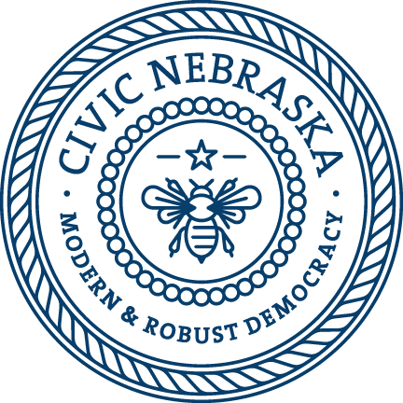
NE State Government 101
You will learn about:
The three branches of government in Nebraska
The history of the Unicameral
How a bill becomes a law in Nebraska

Slide 2
3 Branches of Government
Legislative | Executive | Judicial
Makes Laws | Enforces Laws | Interprets Laws
Notes:
From USA.gov: The Constitution of the United States divides the federal government into three branches to make sure no individual or group will have too much power:
Legislative—Makes laws (Congress, comprised of the House of Representatives and Senate)
Executive—Carries out laws (president, vice president, Cabinet, most federal agencies)
Judicial—Evaluates laws (Supreme Court and other courts)
Each branch of government can change acts of the other branches:
The president can veto legislation created by Congress and nominates heads of federal agencies.
Congress confirms or rejects the president's nominees and can remove the president from office in exceptional circumstances.
The Justices of the Supreme Court, who can overturn unconstitutional laws, are nominated by the president and confirmed by the Senate.
This ability of each branch to respond to the actions of the other branches is called the system of checks and balances.
All three branches of government also exist at the state level. Powers not granted to our federal government are divided between state and local governments. For more information, click here.

Slide 3
3 Branches at the National Level
Legislative | Executive | Judicial
House of Representatives (435 Members of Congress ) Senate (100 Senators) | President | US Supreme Court (9 Justices)
Notes:
Our Nebraska federal delegation: https://www.nebraska.gov/government/federal-government/
From the Truman Library: Our federal government has three parts. They are the Executive, (President and about 5,000,000 workers) Legislative (Senate and House of Representatives) and Judicial (Supreme Court and lower Courts).
The President of the United States administers the Executive Branch of our government. The President enforces the laws that the Legislative Branch (Congress) makes. The President is elected by United States citizens, 18 years of age and older, who vote in the presidential elections in their states. These votes are tallied by states and form the Electoral College system. States have the number of electoral votes which equal the number of senators and representatives they have. It is possible to have the most popular votes throughout the nation and NOT win the electoral vote of the Electoral College.
The Legislative part of our government is called Congress. Congress makes our laws. Congress is divided into 2 parts. One part is called the Senate. There are 100 Senators--2 from each of our states. Another part is called the House of Representatives. Representatives meet together to discuss ideas and decide if these ideas (bills) should become laws. There are 435 Representatives. The number of representatives each state gets is determined by its population. Some states have just 2 representatives. Others have as many as 40. Both senators and representatives are elected by the eligible voters in their states.
The Judicial part of our federal government includes the Supreme Court and 9 Justices. They are special judges who interpret laws according to the Constitution. These justices only hear cases that pertain to issues related to the Constitution. They are the highest court in our country. The federal judicial system also has lower courts located in each state to hear cases involving federal issues.
All three parts of our federal government have their main headquarters in the city of Washington D.C.

Slide 4
3 Branches at the State Level
Legislative | Executive | Judicial
Nebraska Unicameral (49 state senators) | Governor | NE Supreme Court (7 Justices)
Notes:
Who heads each branch of government at the state level?
Legislative: Nebraska Unicameral, our state legislature. We did not always have a Unicameral. From 1867 to 1937, we had a two house system like all other state legislatures.
Executive: Lead by our Governor, but there are 7 executive branch officials that we vote for in Nebraska, including Governor, Lt. Governor, Secretary of State, Auditor of Public Accounts, State Treasurer, and Attorney General. This is different than the federal system where the President appoints his/her candidate.
Judicial: The Constitution of the State of Nebraska distributes the judicial power of the state among the Supreme Court, Court of Appeals, ­district courts, and county courts. All state courts operate under the administrative direction of the Supreme Court.
In addition to the courts created by the Constitution, the Nebraska judicial system has two other courts – the separate juvenile courts located in Douglas, Lancaster, and Sarpy Counties, and a statewide Workers’ Compensation Court.

Slide 5
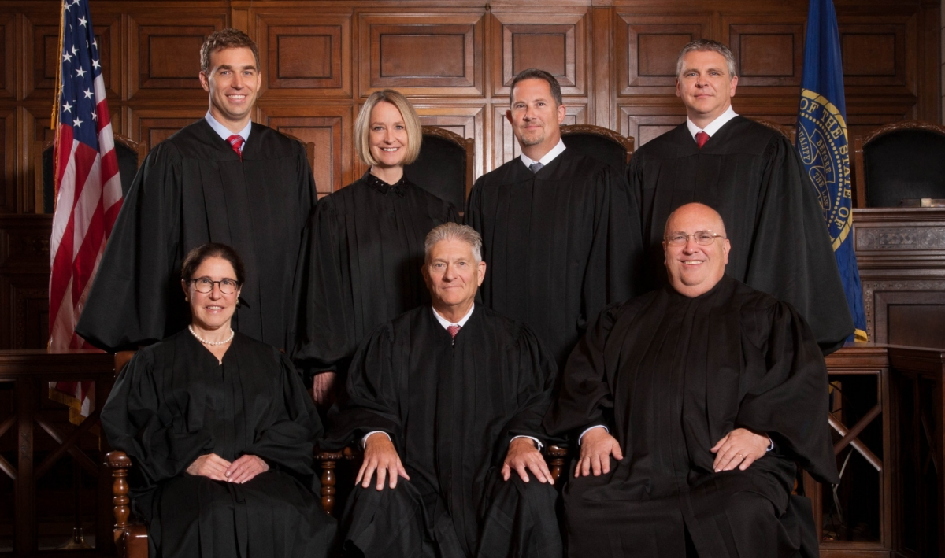
Nebraska Supreme Court
7 Supreme Court Justices
Appointed and Voted to Retain
Retention election once every 6 years
2 Women: Lindsey Miller-Lerman & Stephanie Stacy
Notes:
From the Nebraska Judicial Branch: The Supreme Court consists of a Chief Justice and six associate ­justices. The Chief Justice, who represents the state at large, is appointed by the Governor from a statewide list of candidates selected by a judicial nominating commission. The six remaining associate justices are chosen by the same judicial nominating commission procedure but each represents one of six districts. These judicial districts are approximately equal in population and are redistricted by the Legislature after each census. Three years after first being appointed the court, each justice stands for retention on the ballot. Thereafter, they stand for retention every six years.
The Supreme Court’s basic responsibilities are to hear appeals and provide administrative leadership for the state judicial system. The Supreme Court has the authority to be the original court in which a case is heard under certain circumstances. The Supreme Court also hears all appellate cases regarding the death penalty, the sentence of life imprisonment, or constitutional questions. Upon the granting of a petition for further review, a Court of Appeals case is moved to the Supreme Court for review.
Besides appeals, the Supreme Court is responsible for the regulation of the practice of law in Nebraska. The Supreme Court handles the admission of attorneys to the Nebraska State Bar Association, as well as attorney discipline. This membership is mandatory in order to practice law within the state. Another responsibility of the Supreme Court includes the monitoring and appointment of attorneys to serve on local committees of inquiry, as well as state committees on discipline and professional responsibility.

Slide 6
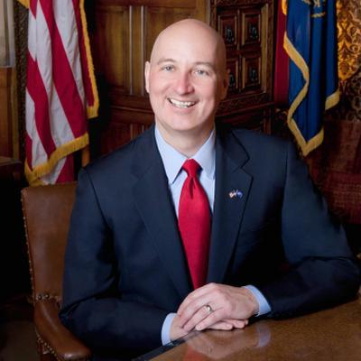
Governor of Nebraska
Governor Pete Ricketts
4 Year Terms
Elected in Midterm Elections (2022)

Slide 7
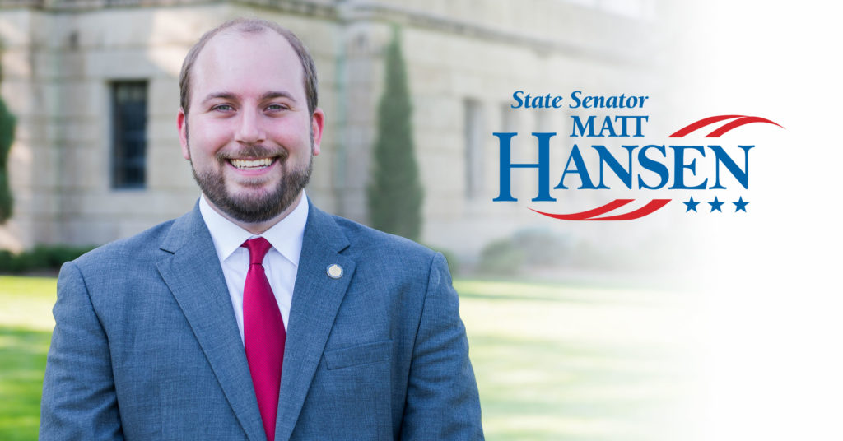
State Senator Matt Hansen
Legislative District 26
Represents Lincoln Northeast!

Slide 8
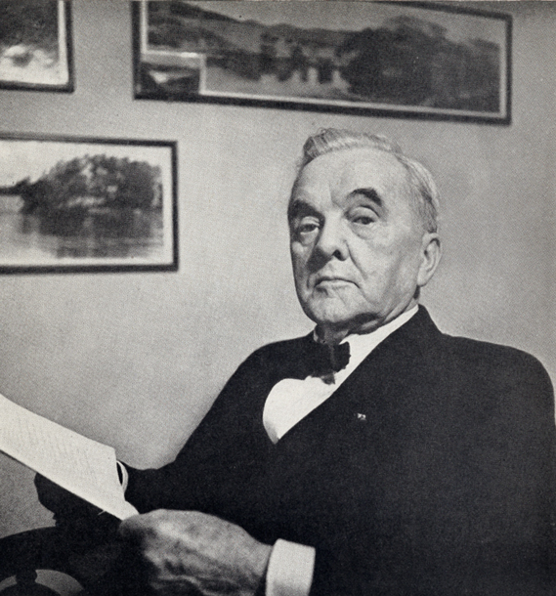
History of the Unicameral
Nebraska became a state in 1867
At first, we had a House of Representatives and State Senate
In 1934, Nebraskans voted to become a one-house system: the Unicameral
George Norris: US State Senator and the “Father” of the Unicameral
Notes:
Overview and History:
The state of Nebraska is the only state in the country that does not have a bicameral legislature. Instead, the Nebraska Legislature has only one house - called the Unicameral - that serves the citizens of the state. Representatives from the Unicameral are called senators.
Nebraska was a bicameral (two house) legislature with a Senate and House of Representatives from statehood in 1867 until 1937. We became a one-house system through a voter-initiated constitutional amendment adopted in 1934. The first Unicameral session convened in 1937.
Why a Unicameral?
The idea was first proposed in Nebraska by Rep. John Norton in 1913. The proposal failed and was followed by several additional unsuccessful attempts. The main driving force behind the 1934 effort was U.S. Sen. George Norris of McCook. The Unicameral was promoted as a money saver – which was a popular idea during the Great Depression. Other issues on the ballot also helped: local option repeal of Prohibition and authorization of pari-mutuel wagering (expanded gambling related to horse races). The campaign was to “Vote Yes on All Three.”
Norris famously wore out two sets of tires driving across Nebraska to campaign for the amendment, which was adopted on a vote of 286,086 to 193,152.

Slide 9
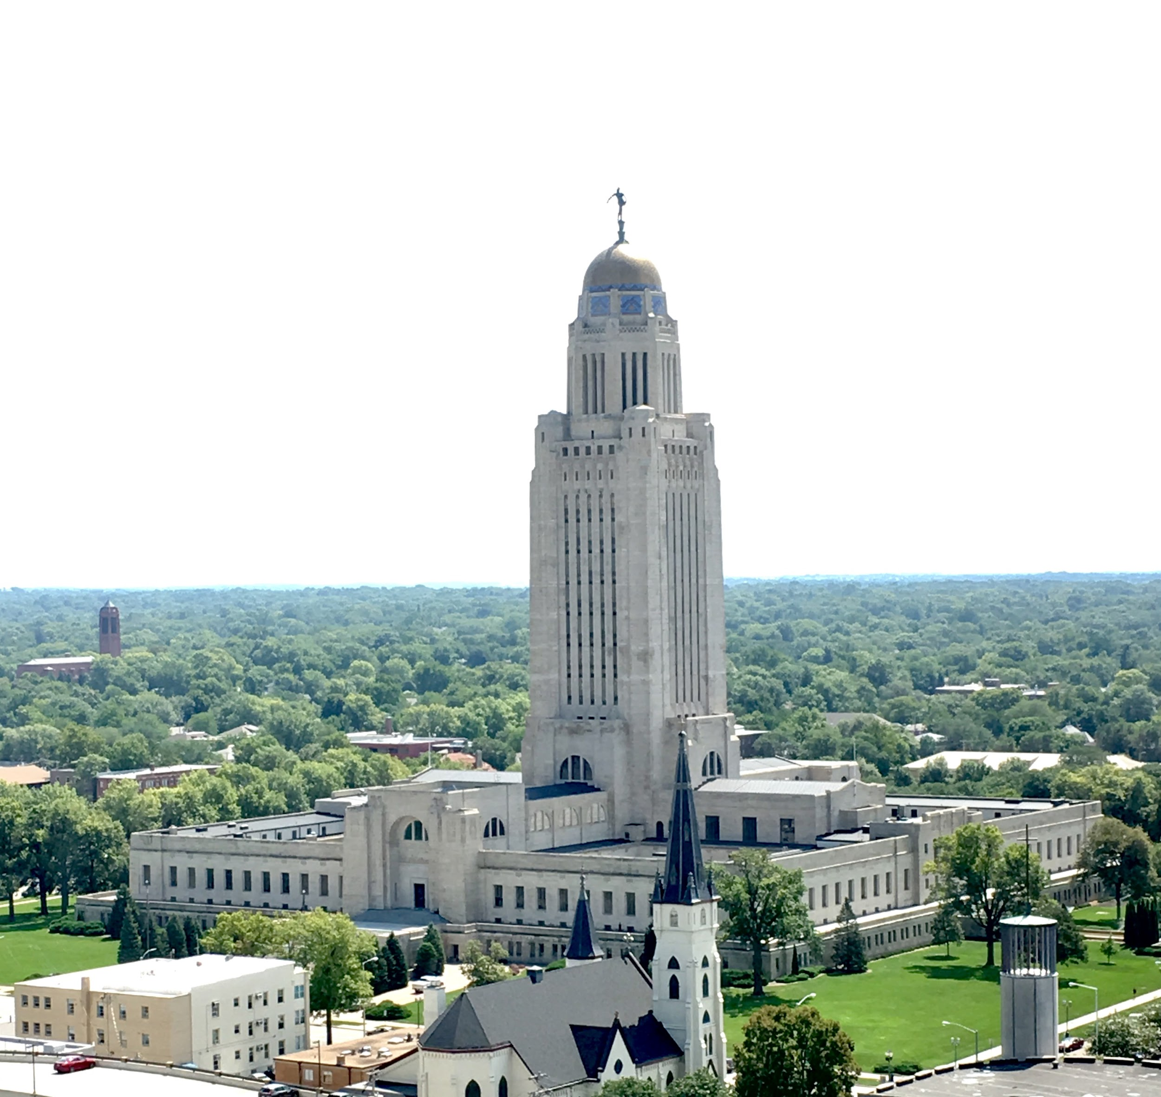
Why a Unicameral?
Save Money.
Increase efficiency – process goes faster.
The Citizen Legislature: centering the role of the people!
Notes:
From the Nebraska Legislature Website: Norris argued that a unicameral legislature would use a more fair and efficient system of lawmaking than the bicameral legislature currently in existence. Additionally, he argued that a small, unicameral legislature would be less expensive and would do a better job at representing the citizens of Nebraska than the larger two-house body.
Since 1937, Nebraska's unicameral legislature the smallest state legislature in the country has consisted of 49 senators from across the state who each serve for four years. Each of the 49 senators comes from a legislative district, which is the small area of the state that the senator represents and serves in the unicameral.

Slide 10
Unicameral Facts
49 senators
Each senator represents ~37,000 people
Nonpartisan!
Average age of senators: 60
How old do you have to be to run? 21
4 Year Terms, can serve two consecutive terms (8 years total)
State Senator Salary: $12,000
Biennial schedule: 1st Year is 90 Days, 2nd Year is 60 Days
Notes:
Basic Structure:
49 senators (constitutionally can go up to 50) representing approximately 37,000 constituents each.
Must be 21 years old, resident of the district for one year prior and registered to vote.
Senators are paid $12,000 per year (set in the constitution) last raised in 1988. The average annual salary in Nebraska is approximately $39,000.
The Legislature operates on a biennial (two-year) calendar: it meets during odd-numbered years for 90 legislative days (adjourn early June) and for 60 days during even-numbered years (adjourn mid-April).
Regular sessions convene on the first Wednesday after the first Monday in January.
Senators may be called into special session for a specific purpose by the governor or two-thirds (33 members) of the Legislature.

Slide 11
Committee Decision
*25 Votes to Go On.
*30 Votes to Overturn Veto!
Ballot Initiative
100,000 Signatures
Needed!
Notes:
Process – Bill Introduction:
Senators get ideas for bills from personal experience, constituents, interest groups, state agencies and the governor. They also conduct research with their staff during interim on public policy issues.
Ideas are taken to bill drafters to be put in the form of a legislative proposal
Most bills are introduced within the first 10 days of session
Bills are read into the record and assigned a number
Reference Committee sends each bill to a standing committee based on subject matter jurisdiction
Committees:
A public hearing is held on all but a few technical bills
Anyone may testify at a hearing
This is the main opportunity for citizen input on public policy
Committees can vote to advance the bill – with or without amendments – indefinitely postpone (kill) it or take no action, effectively holding the bill in committee
General File:
The first round of debate is the first opportunity for the entire legislature to consider a bill
As a result, this is the stage where most debate and compromise happens
Any senator may propose an amendment
Each senator is allowed three turns at the microphone of five minutes each to support or oppose a bill and to ask questions of other members
Adoption of amendments and advancement of the bill require a simple majority of 25 votes
Select File:
The second round of debate is another opportunity to debate and amend a bill
It again takes 25 votes to advance a bill, although bills often are advanced to the final stage of debate by voice vote
Final Reading:
Bills are not debated on final reading, but may be returned to select file for a specific amendment
25 votes are required for passage of a bill, unless it takes effect immediately (e-clause) in which case 33 votes (2/3 majority) are required. Proposed amendments to the Nebraska Constitution require 30 votes (3/5 majority)
Governor:
Bills passed by the Legislature are sent to the governor for his or her consideration
The governor has five days – excluding Sunday – to consider a bill. If the governor signs a bill or declines to act on it, the bill becomes law
The governor may veto a bill, and may also line-item veto budget items
The Legislature may override a gubernatorial veto with 30 votes (3/5 majority)
Ballot Initiative:

Slide 12
Committee Room: Public Hearings
7-9 Senators per Committee
Anyone can testify! For / Against / Neutral
Notes:
From the Nebraska Legislature website:
As a concerned citizen, there are several ways in which you may communicate effectively with your senator in an attempt to suggest or influence legislation. One way is to testify at a legislative hearing.
At public hearings, citizens have an opportunity within the time available to make their views known or have them incorporated into the official committee record. In Nebraska, gubernatorial appointments and most bills, with the exception of a few technical bills, receive a public hearing by one of the Legislature's committees.
Generally, testimony on legislative bills is heard by one of the Legislature's 14 standing committees:
Agriculture
Appropriations
Banking, Commerce and Insurance
Business and Labor
Education
General Affairs
Government, Military and Veterans Affairs
Health and Human Services
Judiciary
Natural Resources
Nebraska Retirement Systems
Revenue
Transportation and Telecommunications
Urban Affairs
Each of these committees has seven to nine members.
Public hearings on bills typically are held in the afternoons during the first half of the legislative session. Committees have assigned hearing rooms and meeting days, although they sometimes meet at different times and places in order to accommodate witnesses or large audiences.

Slide 13
Norris Chamber: “Floor” Debate
General File, Select File, Final Reading
25/49 Votes to get to the next round (33 for a filibuster)

Slide 14
How a Bill Becomes a Law
YOUR TURN!
Notes:
Use the How a Bill Becomes a Law signs to facilitate the activity outlined in the lesson plan guide.

Slide 15
Unicameral Facts
? senators
Each senator represents ~? people
Average age of senators: ?
How old do you have to be? ?
? Year Terms, can serve two consecutive terms (? years total)
State Senator Salary: ?
Biennial schedule: 1st Year is ? Days, 2nd Year is ? Days
Year Nebraska became a state: ?
Year Nebraska adopted the Unicameral: ?
Notes:
Go through these facts “pop quiz” style with your students.

Slide 16
THANK YOU!
Chris McCurdy, Program Manager
chris.mccurdy@civicnebraska.org
402-904-5191 (Office)
402-770-4851 (Mobile)

