Slide 1
EXPANDED LEARNING OPPORTUNITY
INNOVATION NETWORK
Civic Nebraska Center of Excellence

Slide 2
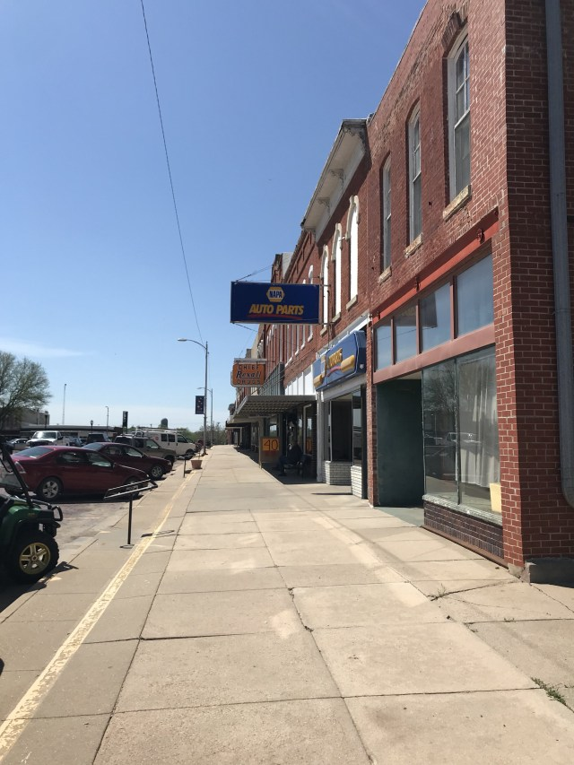
Communities across Greater NE are losing their best and brightest young people. It begs the questions:
How will we keep our young people here in Greater Nebraska?
How will we build communities so that people will not only want to stay, but also want to move into
How will we create the kind of civic pride that will translate into thriving communities for years to come?
Photo here

Slide 3
The new Center of Excellence, through a partnership between Beyond School Bells and Civic Nebraska, will serve as a hub for partnerships, information, and resources from across Greater Nebraska to address those questions.
Photo here

Slide 4
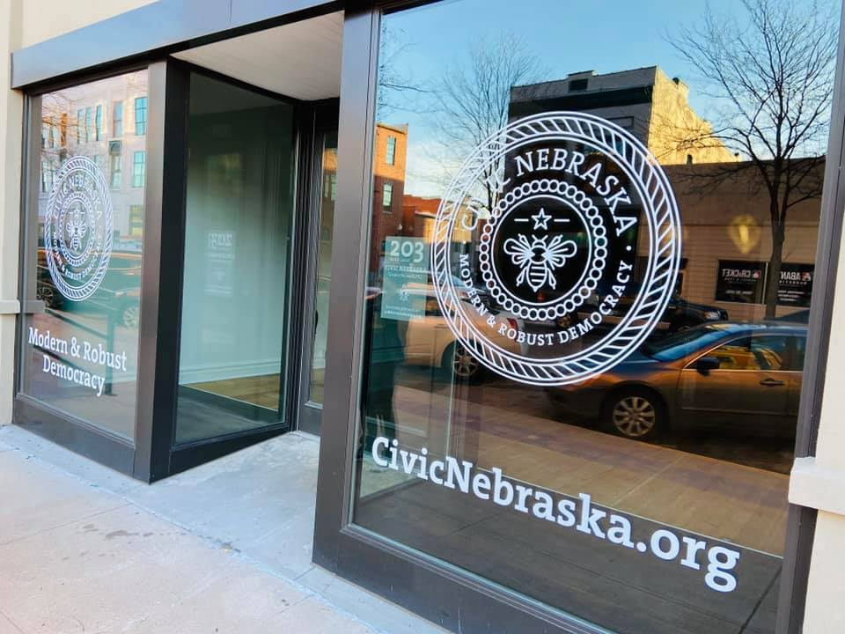
What is the Center of Excellence?
From our new Grand Island office, this collaboration will create a physical and virtual hub for professional development, experiential activities, and community engagement for students, educators, and after school professionals to plan and implement service learning in the after- school space.
The Center of Excellence works to give all stakeholders the opportunity to do meaningful work to support and improve their communities
Photo here

Slide 5
Greater Nebraska Center of Excellence
On site collaboration space for teachers, after school providers, community partners, and students
Virtual archived professional development
Live online presentation and professional development

Slide 6
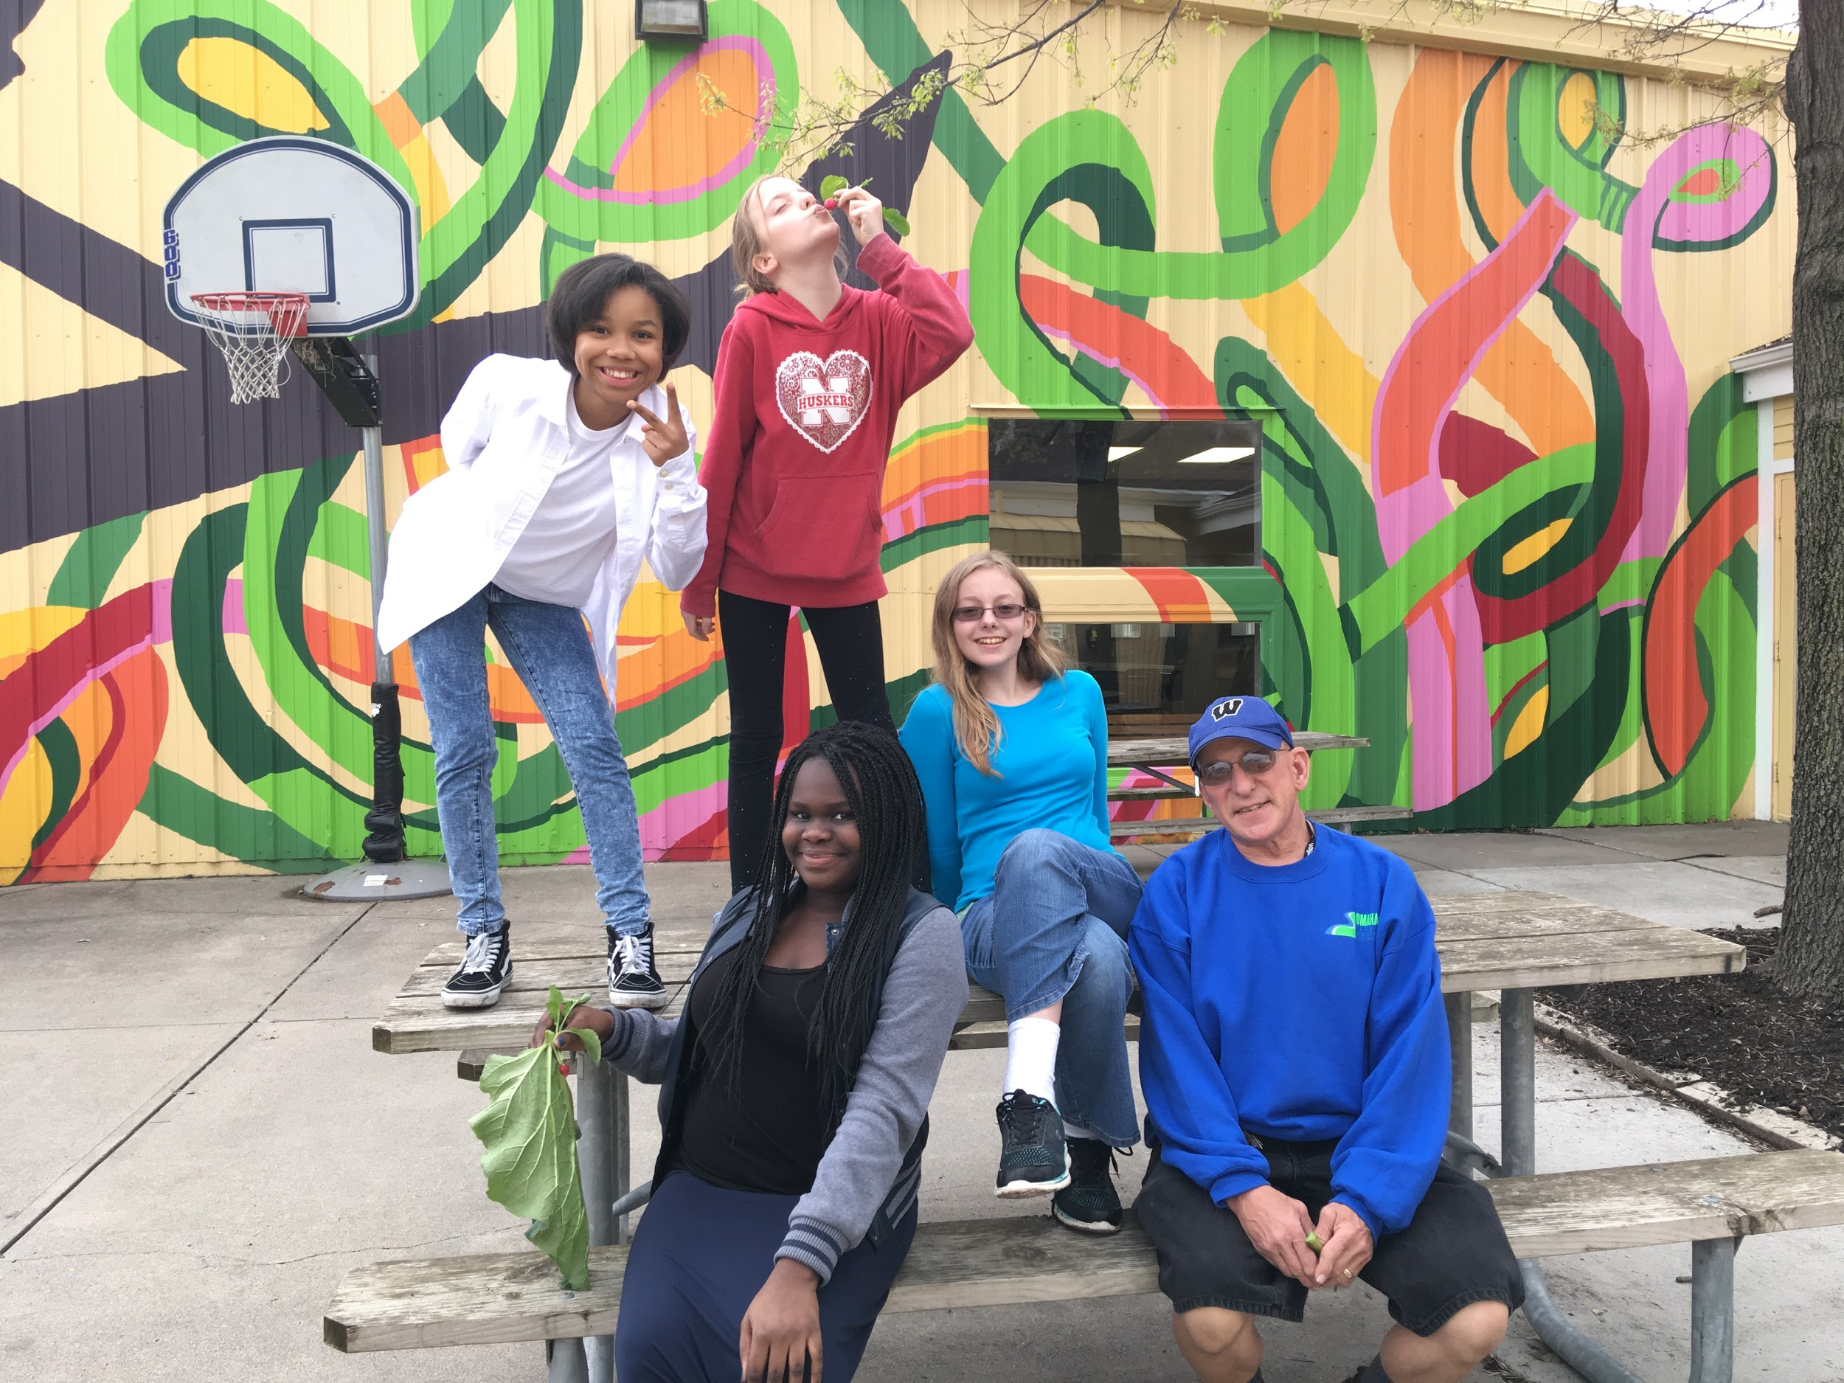
Service Learning
Service-learning is an approach to teaching and learning in which students use academic and civic knowledge and skills to address genuine community needs.
Service-learning is a type of experiential and project-based learning that drives students’ academic interests and passions toward addressing real community needs. The process is a learner-centered cycle of inquiry, compelling young people to answer questions such as:
· What are the true needs in my community?
· What are the root causes of these needs?
· How, where, and from whom can I learn more?
· How can I contribute to a solution?
PHOTO OR GRAPHIC

Slide 7
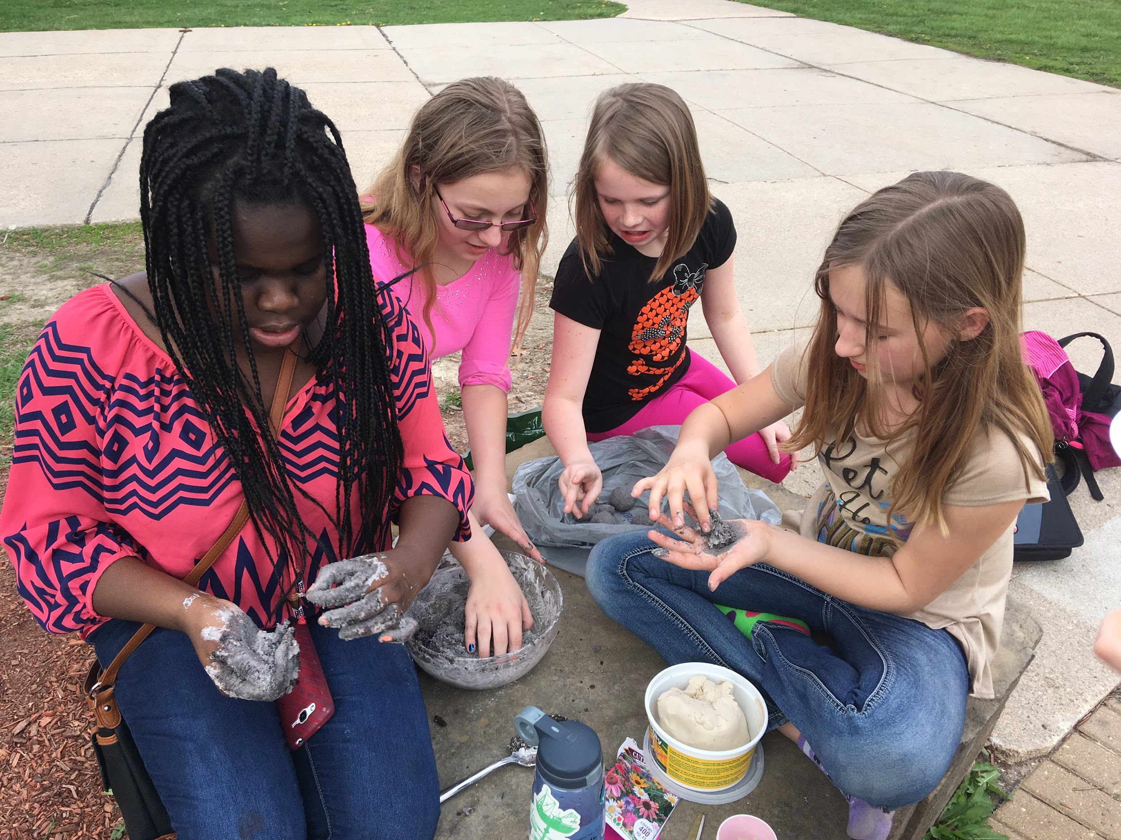
Standards for High Quality Service Learning
Meaningful Service: personal and community relevance
Link to Curriculum: intentional teaching strategy
Reflection: ongoing thinking and analysis
Diversity: understanding and mutual respect
Youth Voice: a voice in planning and implementing
Partnerships: collaborative and mutually beneficial
Progress Monitoring: ongoing assessments
Duration and Intensity: to address community needs

Slide 8
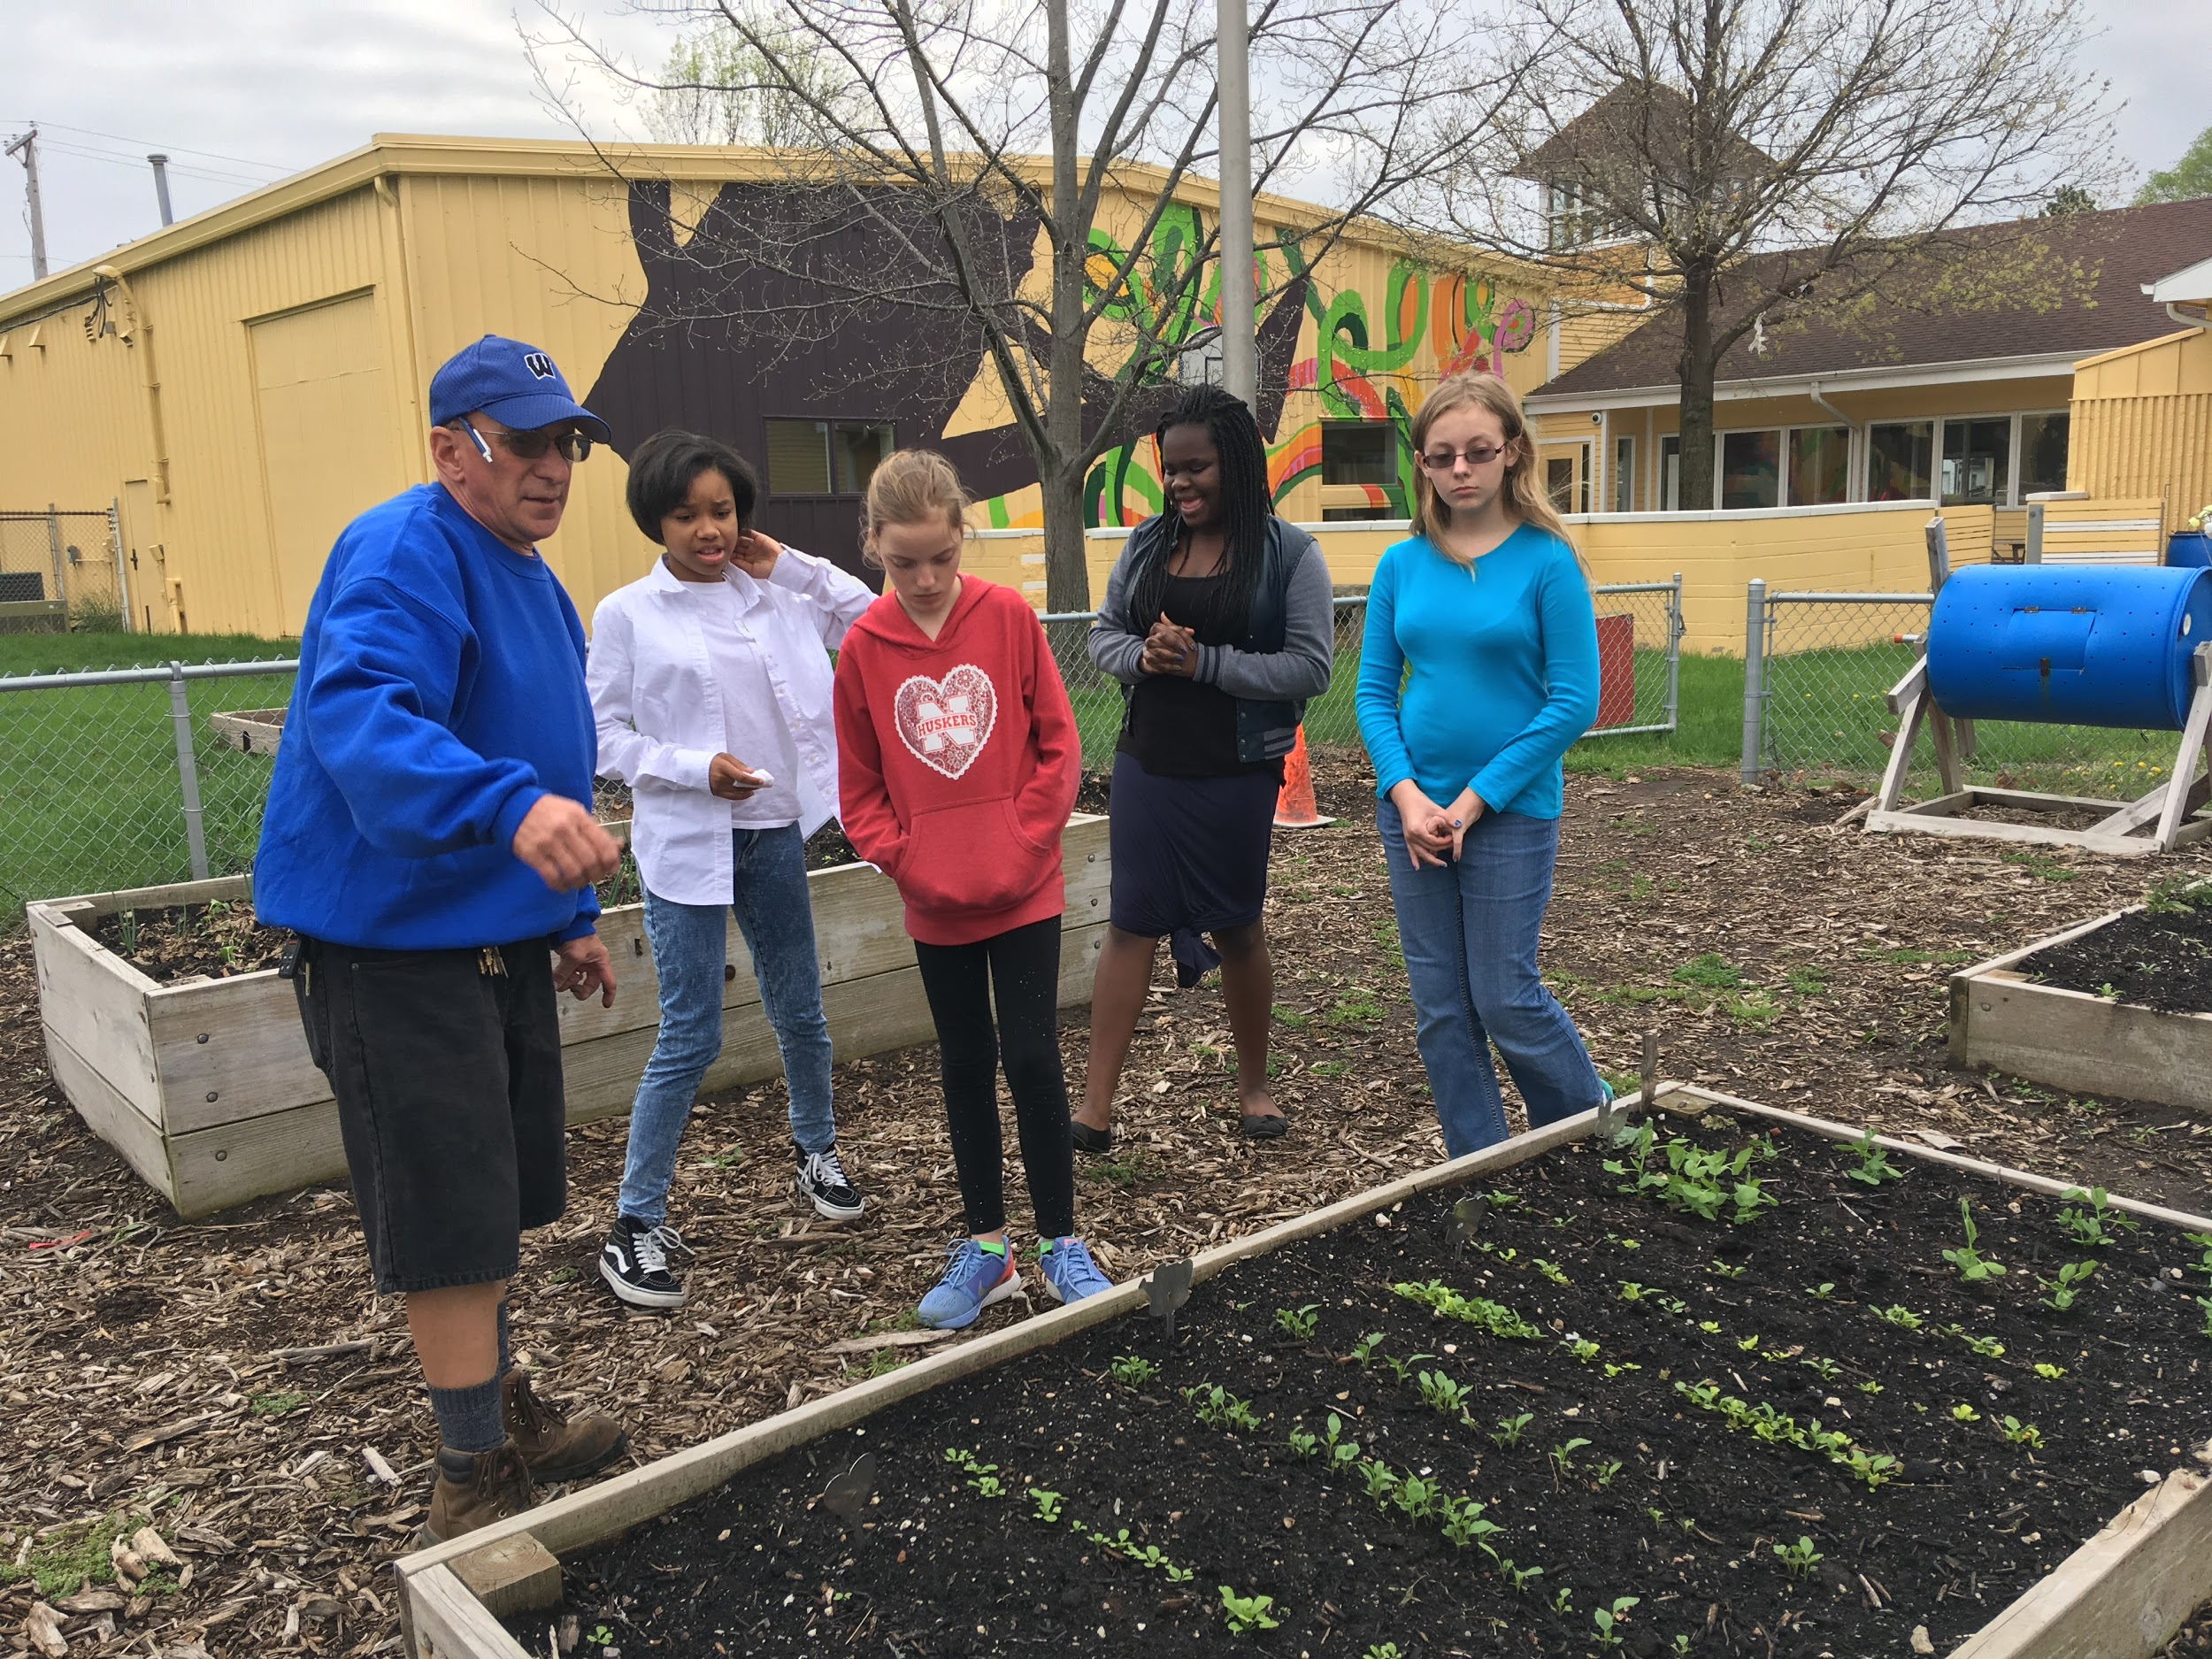
Getting Started in Service Learning
Identify an authentic community need
Research and plan
Identify community partners
Create a plan
Implement
Celebrate
Reflect throughout
Photo here

Slide 9
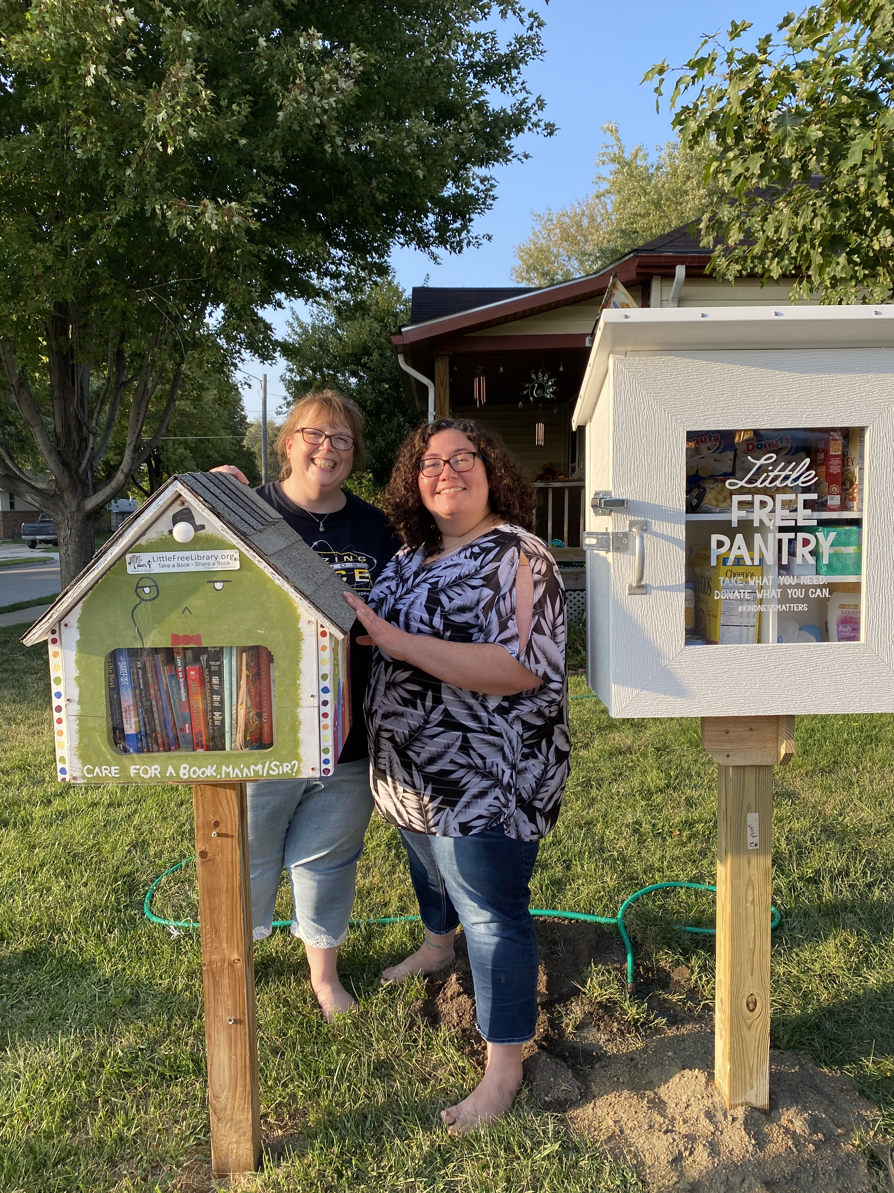
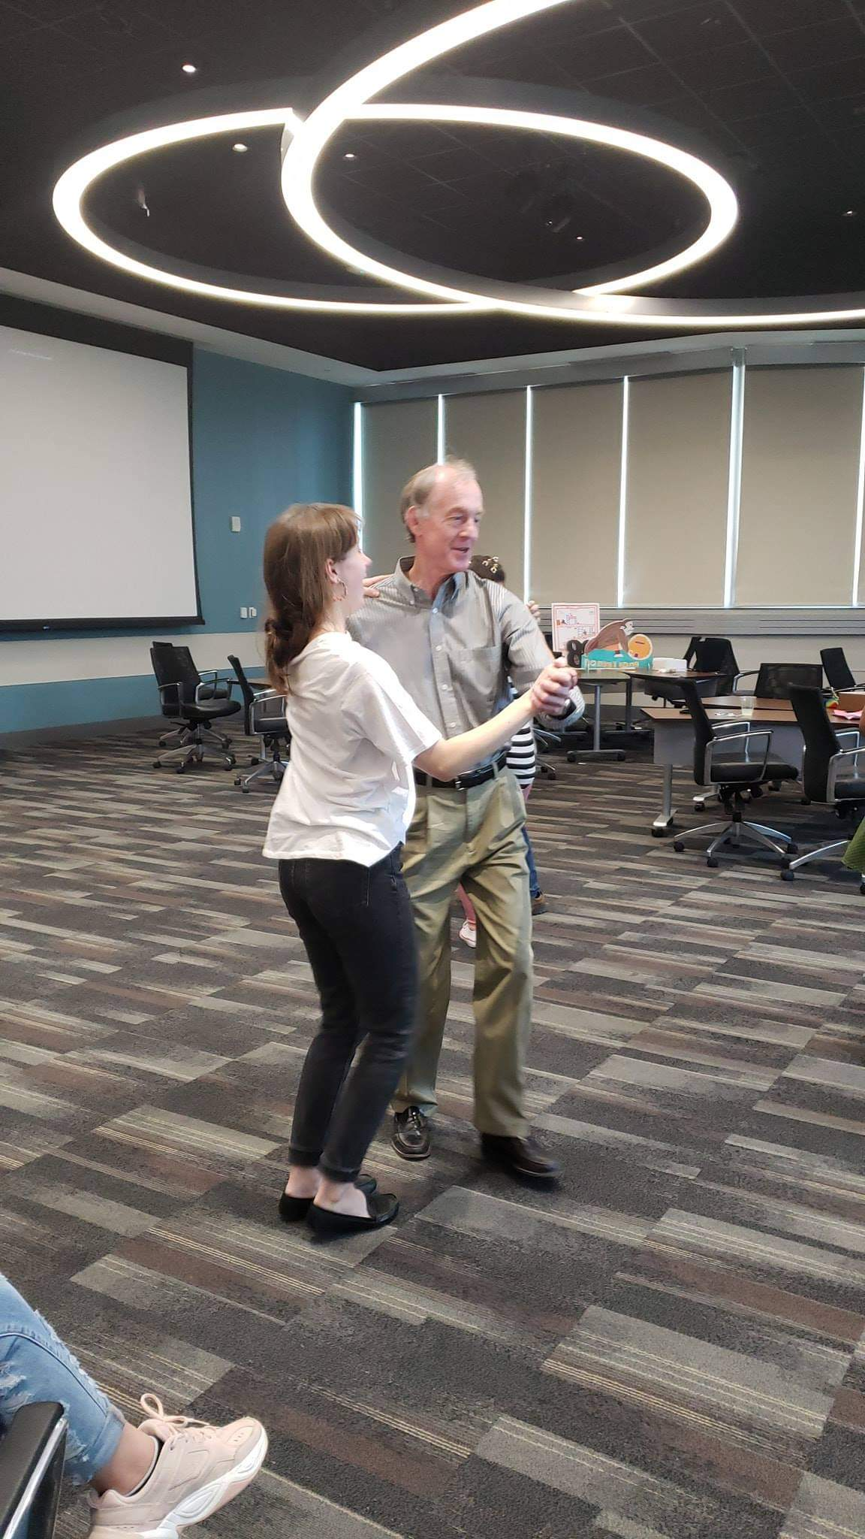
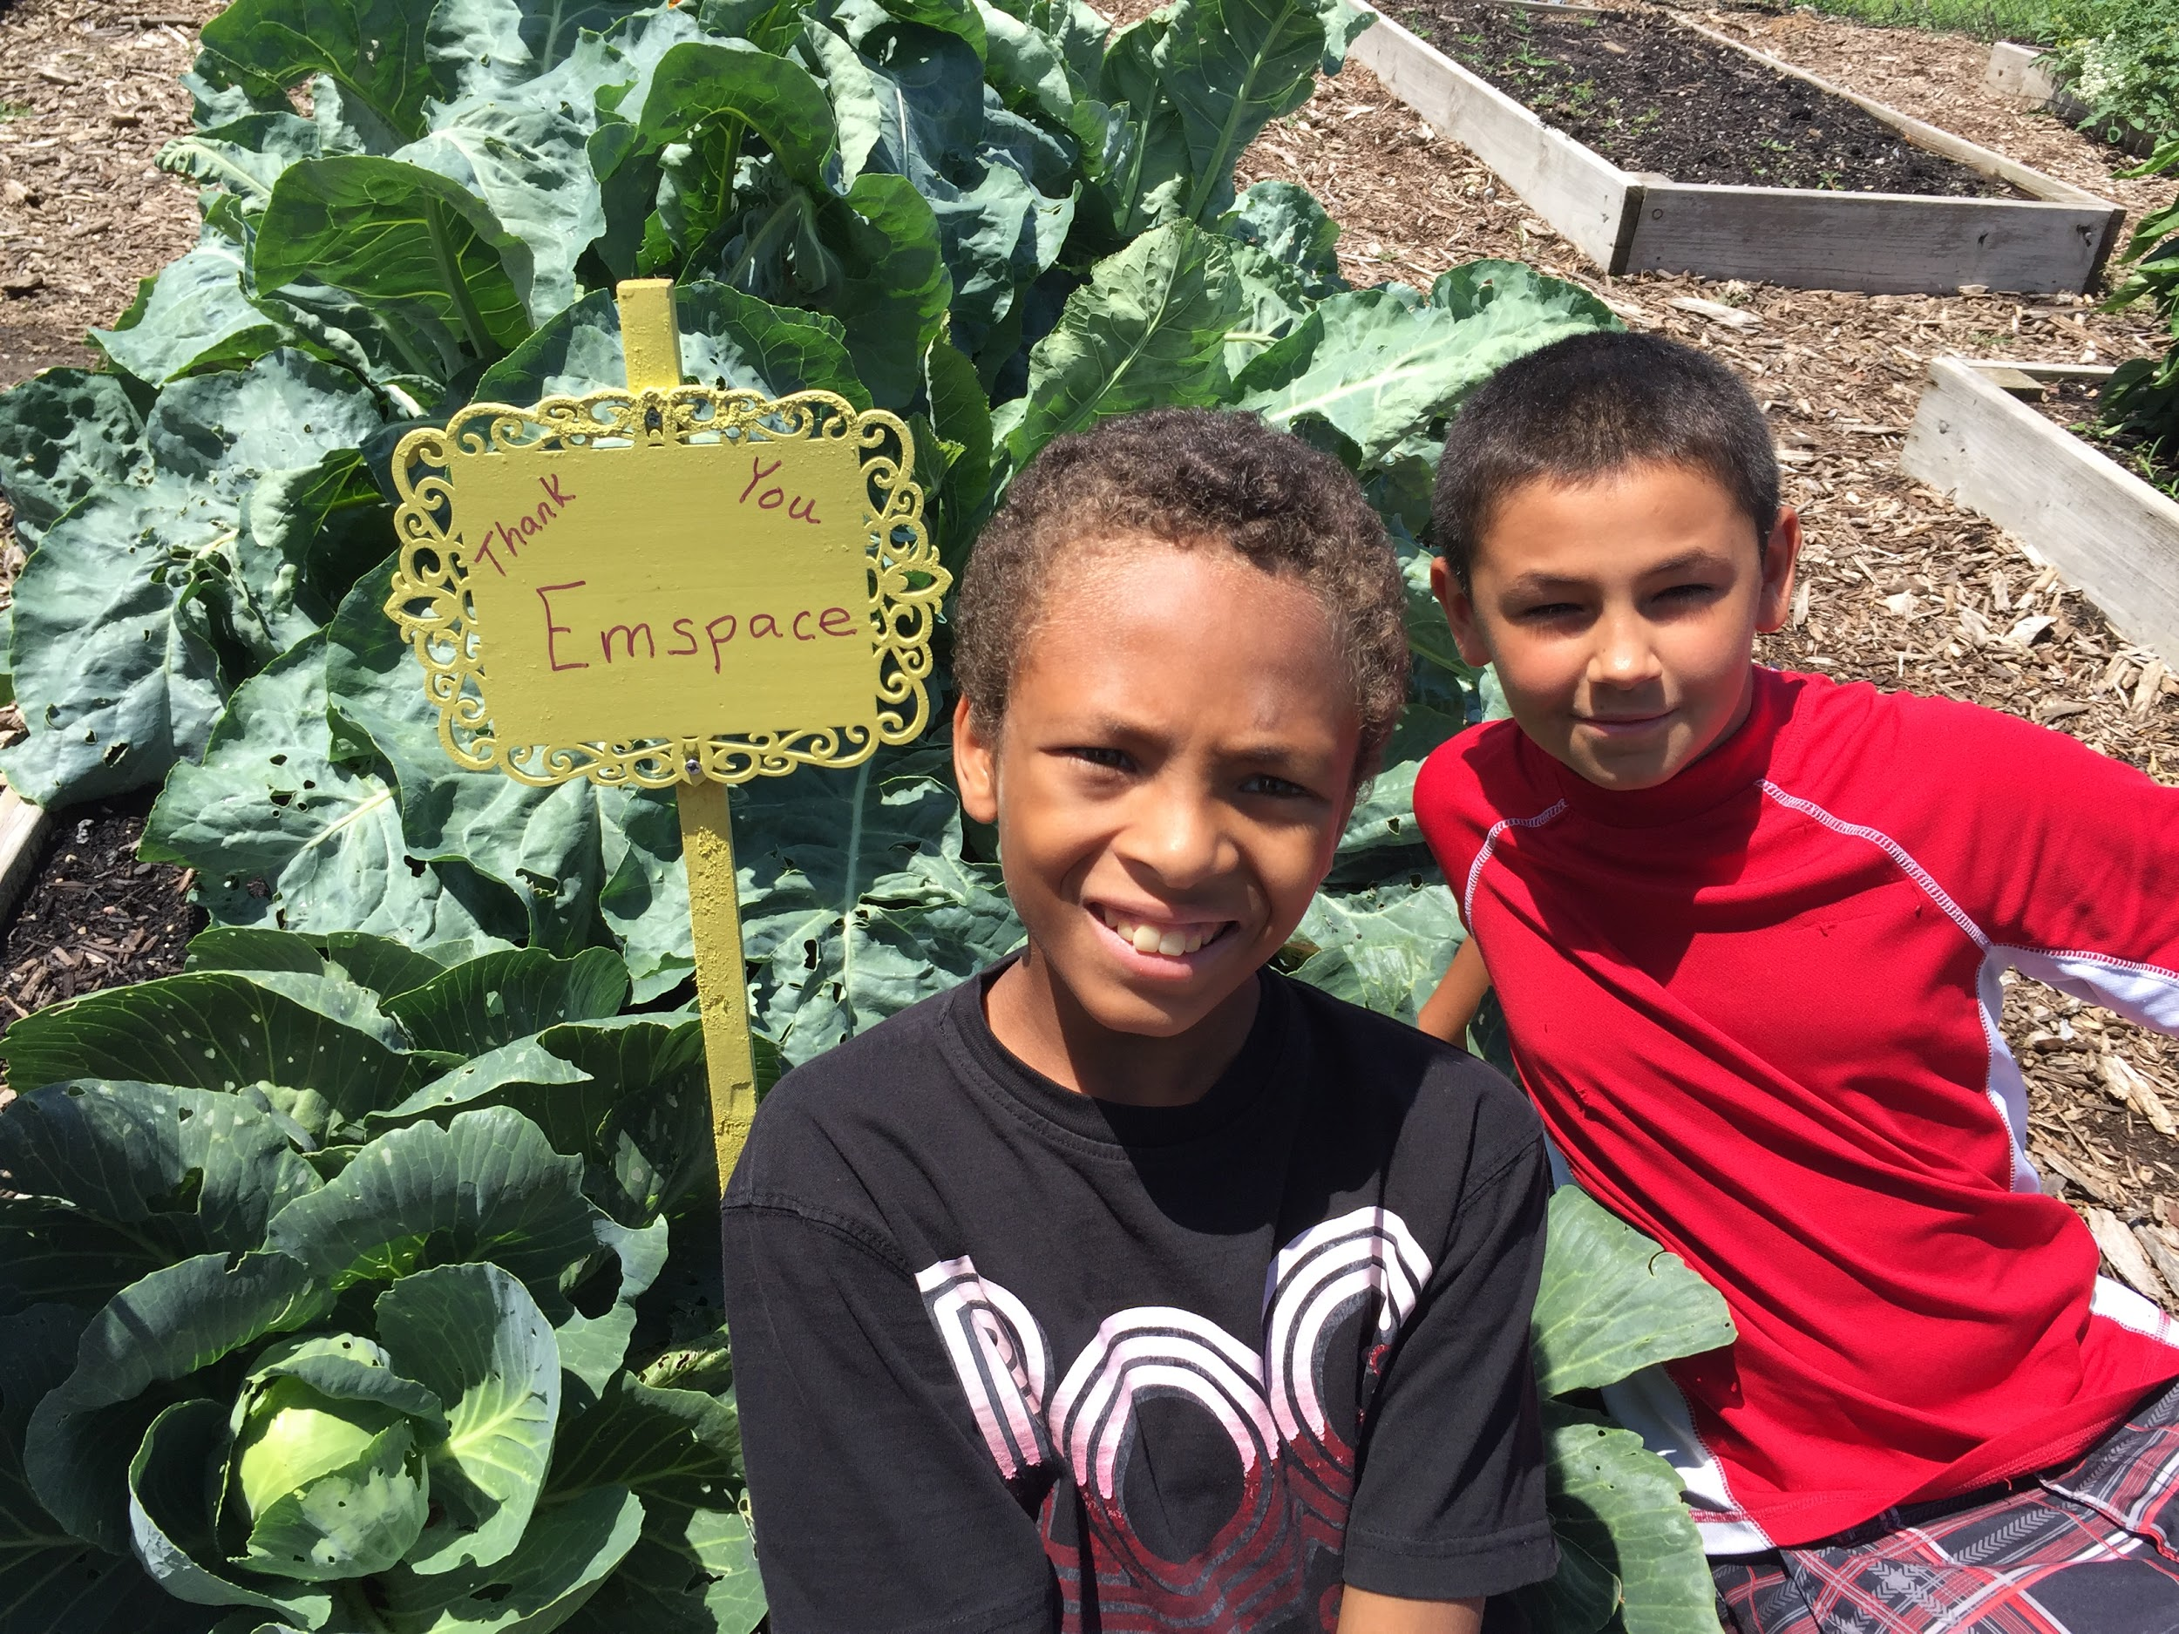
Examples
Community Gardening
One program operated 36 raised bed gardens. Students from K-5 took part in every aspect of the garden and provided the equivalent of 1,000 meals of fresh, healthy produce to local families who were living in a food desert.
Mini Pantries
One student group decided to work on food insecurity in neighborhoods where many families did not have reliable transportation. They partnered with a builder and the food bank and built and filled mini pantries in neighborhoods.
Senior Prom
Students determined that elderly people in their area were often lonely and left out of activities. Students, along with a gerontology class and a retirement home, planned a “Senior Prom.” They had food, music and dancing.

Slide 10
Resources Civic Nebraska Center of Excellence homepage https://www.civicnebraska.org/youth-civic-leadership/service-learning-center-excellence/ Beyond School Bells https://beyondschoolbells.org/ National Youth Leadership Council https://www.nylc.org/

Slide 11
Meeting #2

Slide 12
What does Service Learning do for your community?
Service-learning has a positive effect on students personal and interpersonal development leadership and communication skills
Service-Learning is part of a national movement to increase civic engagement.
Service-Learning helps prepare students for the job market.
Service-Learning provides useful services in the community addressing authentic issues.

Slide 13
Examples
Community Gardening
One program operated 36 raised bed gardens. Students from K-5 took part in every aspect of the garden and provided the equivalent of 1,000 meals of fresh, healthy produce to local families who were living in a food desert.
Mini Pantries
One student group decided to work on food insecurity in neighborhoods where many families did not have reliable transportation. They partnered with a builder and the food bank and built and filled mini pantries in neighborhoods.
Senior Prom
Students determined that elderly people in their area were often lonely and left out of activities. Students, along with a gerontology class and a retirement home, planned a “Senior Prom.” They had food, music and dancing.

Slide 14
Standards for High Quality Service Learning
Meaningful Service: personal and community relevance
Link to Curriculum: intentional teaching strategy
Reflection: ongoing thinking and analysis
Diversity: understanding and mutual respect
Youth Voice: a voice in planning and implementing
Partnerships: collaborative and mutually beneficial
Progress Monitoring: ongoing assessments
Duration and Intensity: to address community needs

Slide 15
Today
Conference Opportunity
National Youth Leadership Council (NYLC)
April 14, 15
Free to you
https://www.nylc.org/page/SLCHome
Service Learning Training
NYLC
Progress on group formation and topic selection
Volunteer Nebraska
Place to look for ideas http://www.volunteernebraska.org/
Turn volunteerism into Service Learning
Mary Ingram, Phillips, NE
An opportunity
Watchable Wildlife NE Game and Parks
http://outdoornebraska.gov/watchablewildlifegrants/
Civic NE 24% matching

Slide 16
Next Steps
Planning Your Project
Possible Subgroups
Partnerships – school or community
Inventory resources
Inventory needs - $, tools, transp
plan steps in the process
Build in Time for Reflection
Teacher/Supervisor’s role
Oversight – schedule, budget
Documentation
Allow for student decisions

Slide 17
Next meeting reflection Forming partnerships

