Slide 1
Spread the Good: Applying for Community Mini-Grants

Slide 2
What is a Mini-Grant?
Grants that are small in nature (under $5,000) designed to execute new projects, provide mutual aid, or produce positive community impact.
Mini-grants are “a way to connect with your neighborhood and your community to bring about positive change,” said Nancy Petitto, Civic Nebraska’s Collective Impact Lincoln program manager

Slide 3
Steps to Writing a Mini-Grant
Surveying Community Needs
Identifying a Mini-Grant or Request for Proposal (RFP)
Connecting with the Funders/Host Organization
Establishing Relevant Partnerships
Drafting an Application & Budget
Revising Application & Budget
Submission

Slide 4
How can YOUR Community be Strengthened?
Identity
Groups
Communities

Slide 5
Example Mini-Grant Ideas

Slide 6
Avoiding Grant Writing Mistakes
Failure to Demonstrate Community Research
Duplicating Services
Lacking community buy-in or partnership cultivation
Unspecified Goals or Timelines
Lacking Appropriate Scope
Failing to follow grant submission guidelines
Unclear or Vague Budgeting

Slide 7
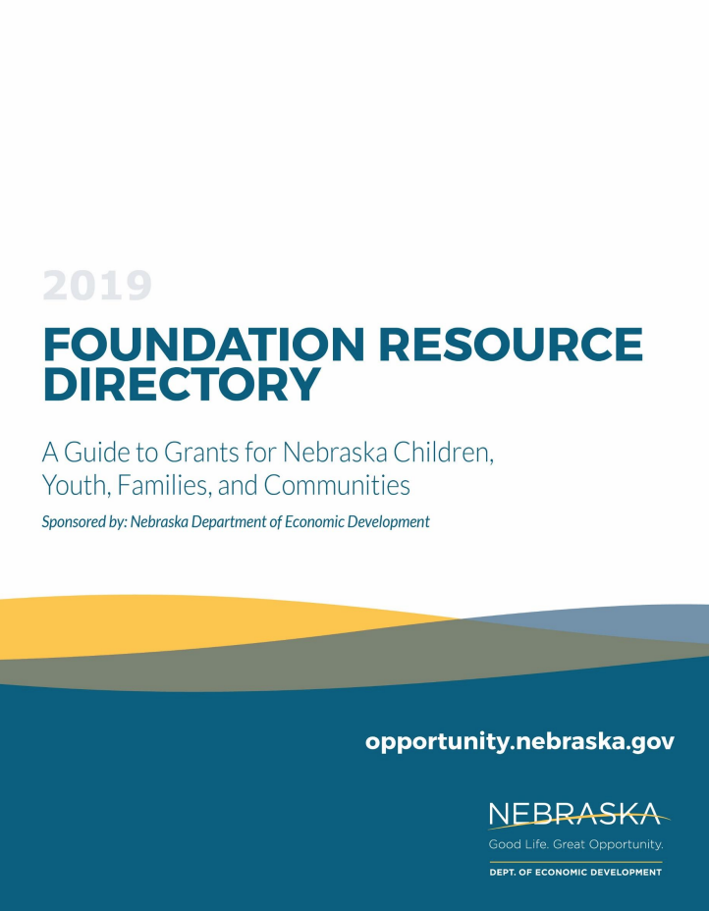
Where to Apply?
Nebraska Department of Economic Development Foundation Resource Directory
Check out Local Community Foundation
Nebraska Arts Council
The Nebraska Civic Engagement Table
Humanities Nebraska
Nebraska Department of Transportation
Child Care Grants through DHHS
Civic Nebraska, Collective Impact Lincoln Mini-Grants

