Slide 1
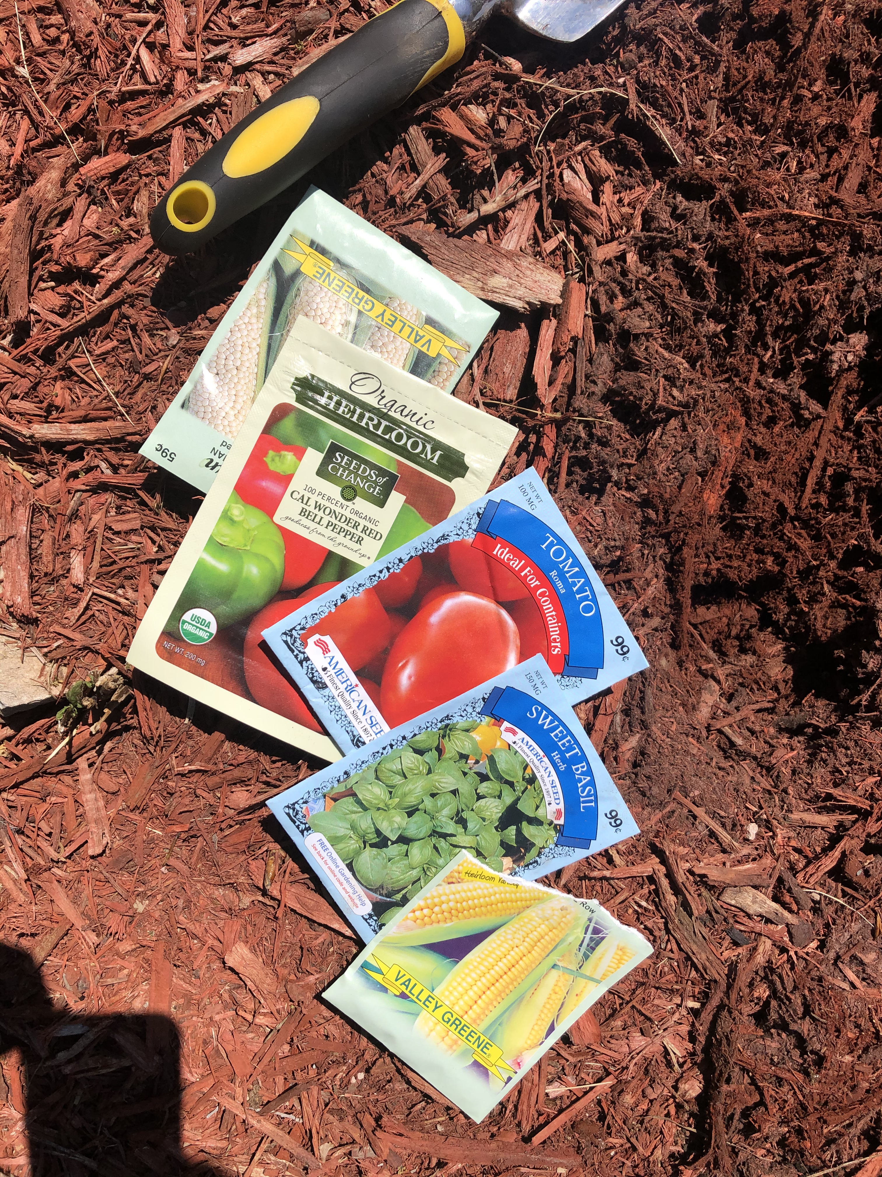
Grow Time
With Lothrop After School Families @Mrs. Equasha Gooch’s Home

Slide 2
Gardening 101 w/Ms. Chris

Slide 3
We will watch our vegetables grow at home

Slide 4
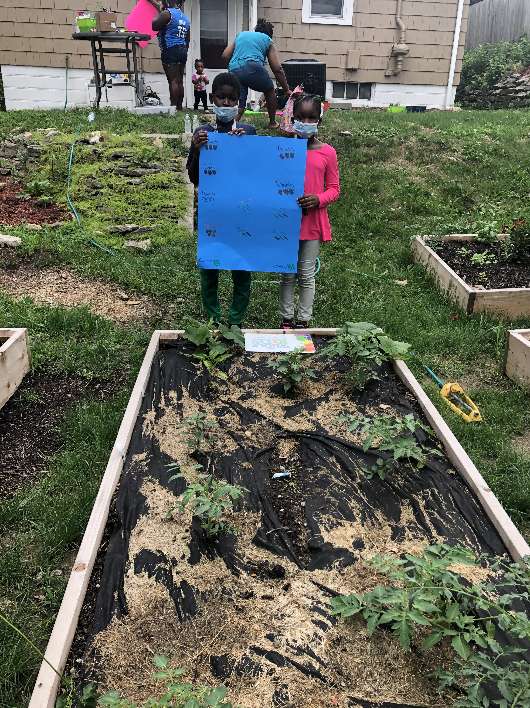
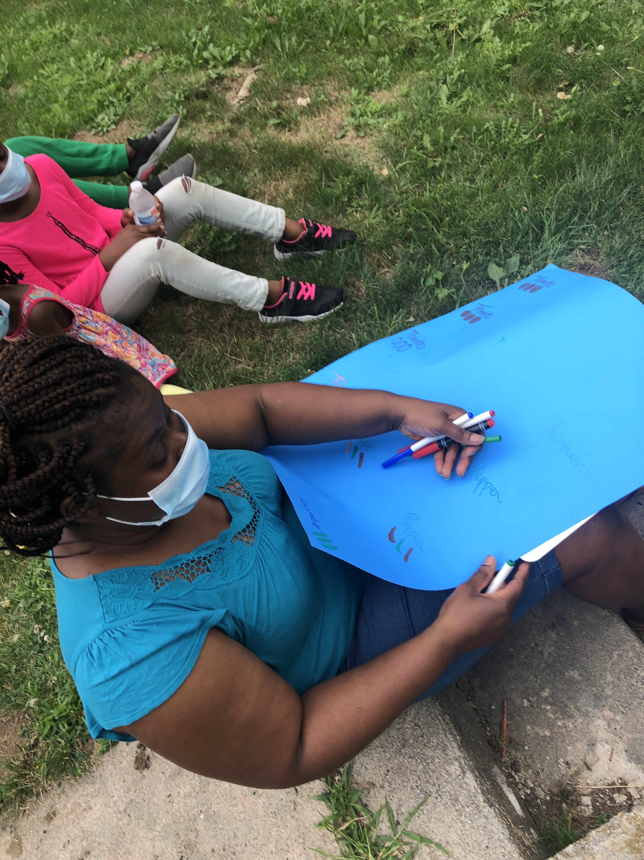
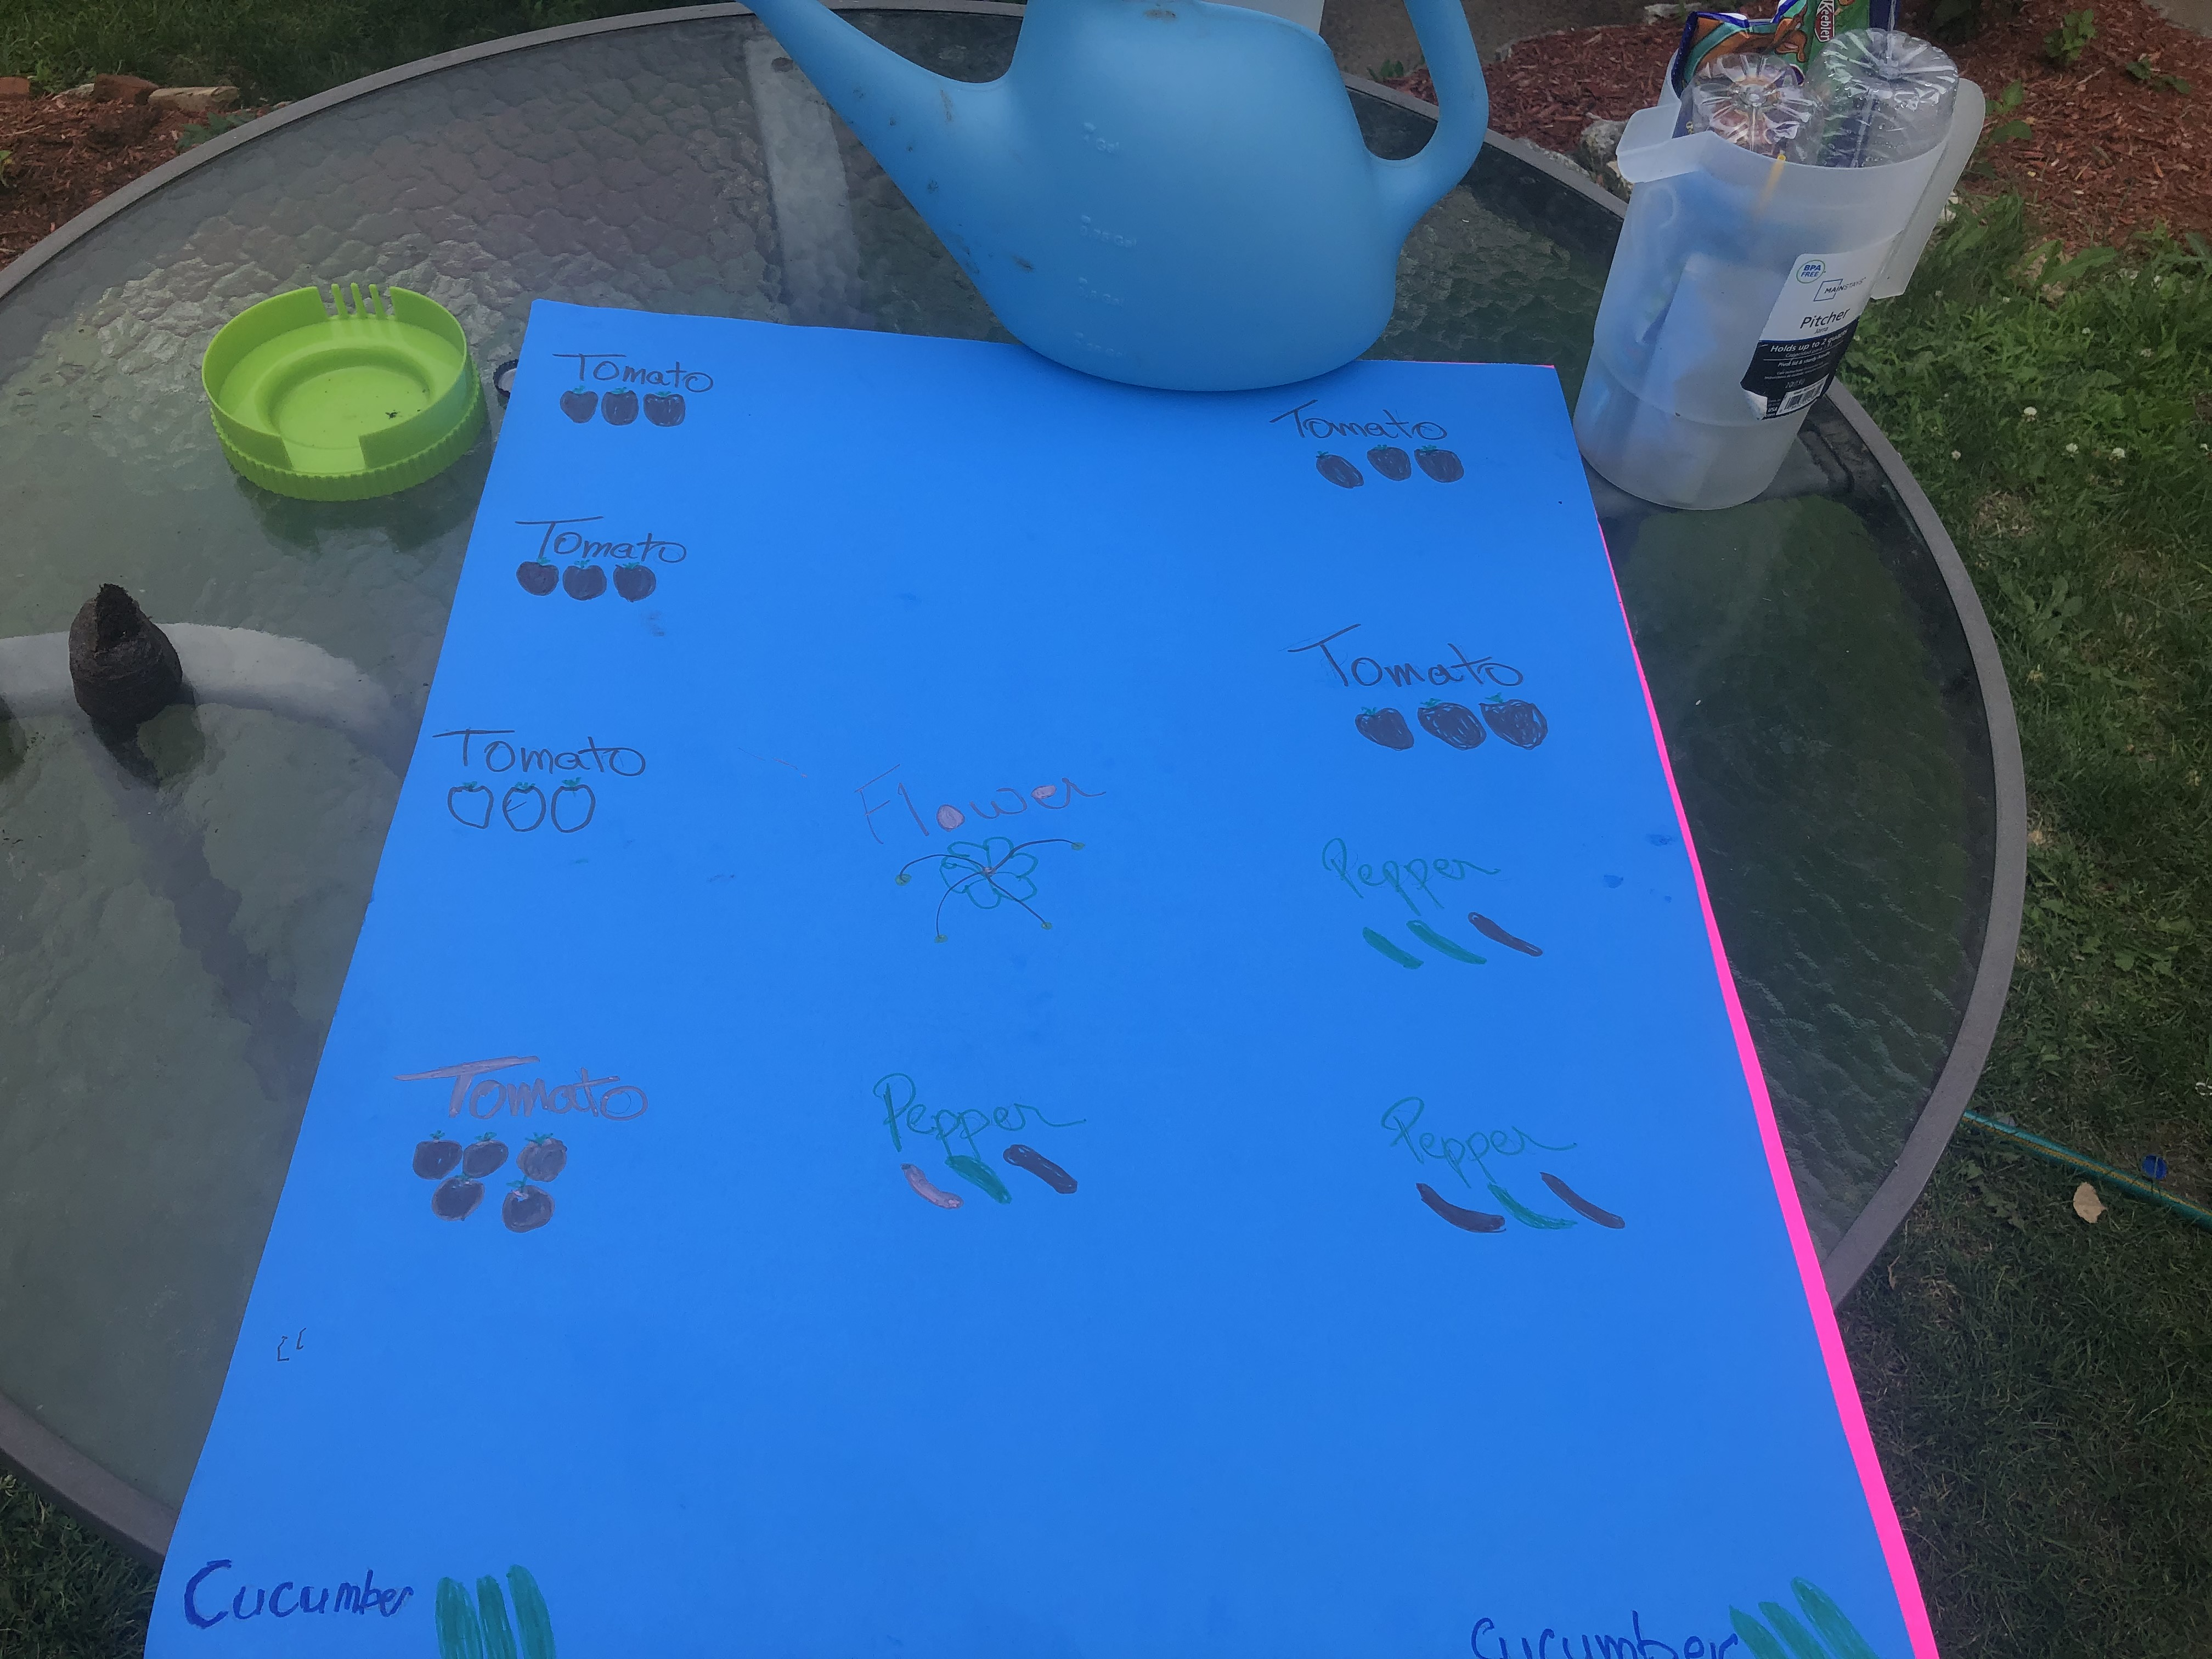
What is growing…???
Cucumbers
Tomatoes
Peppers

Slide 5
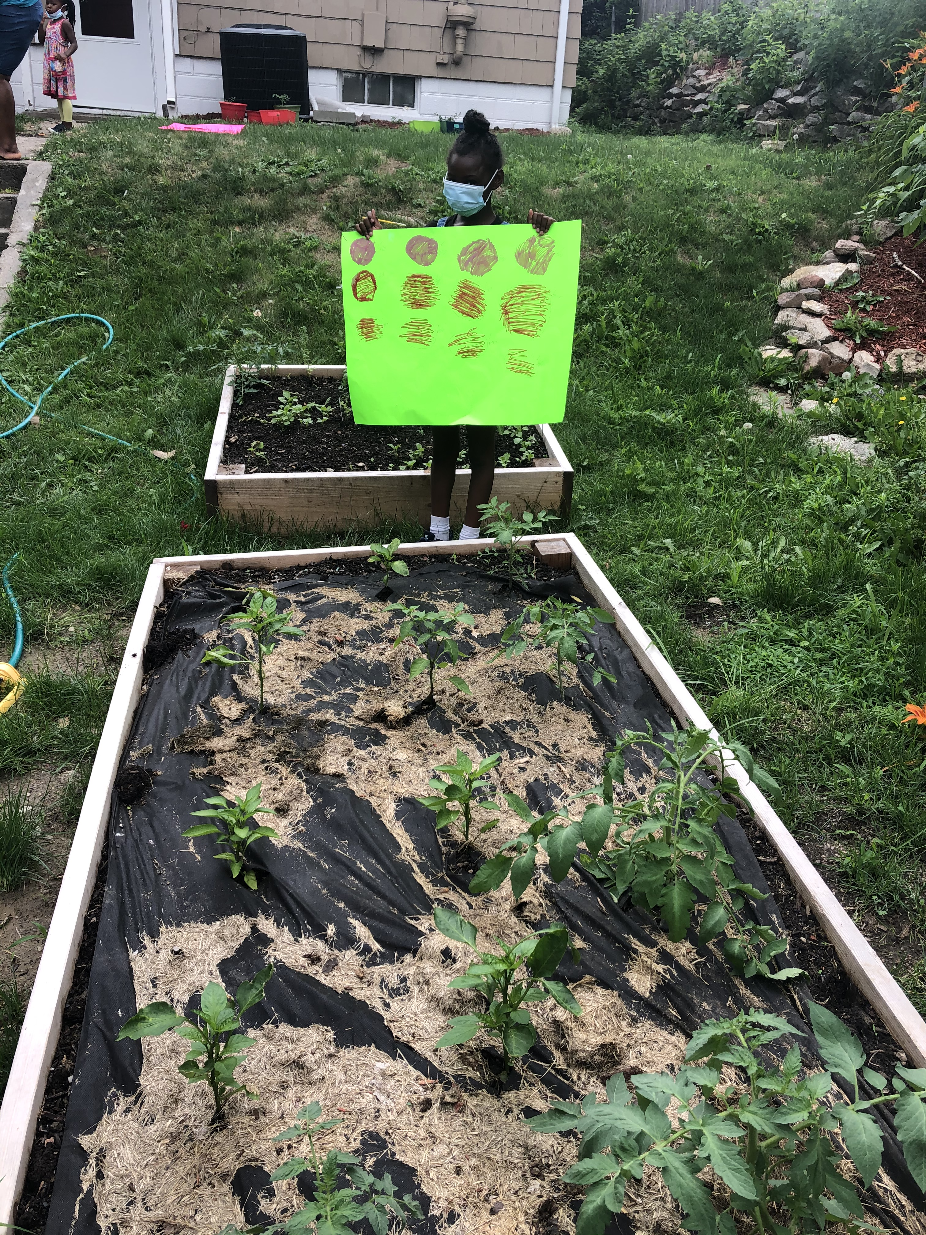
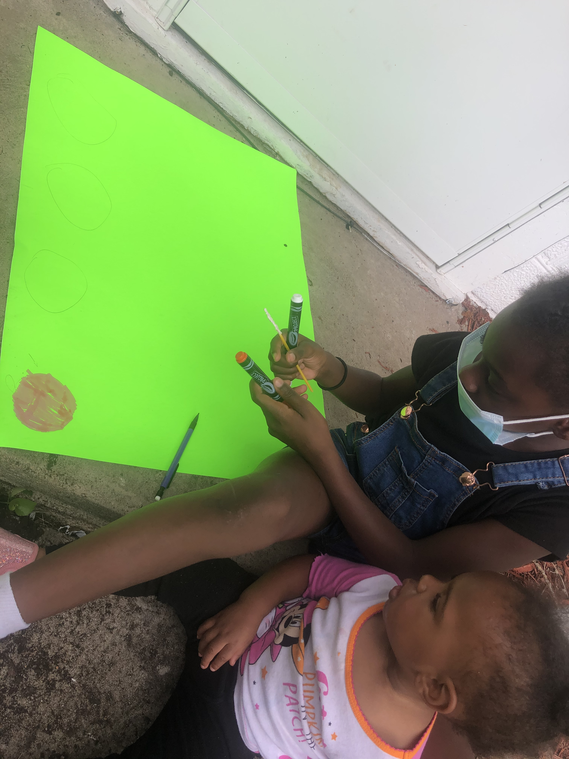
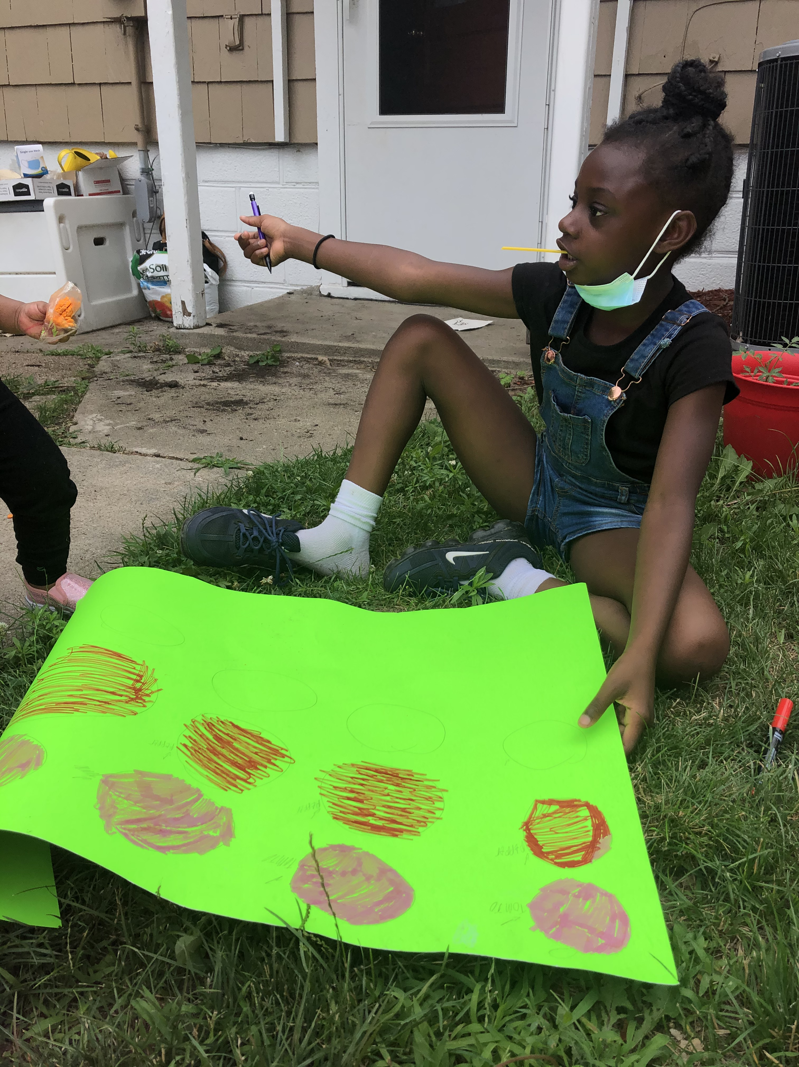
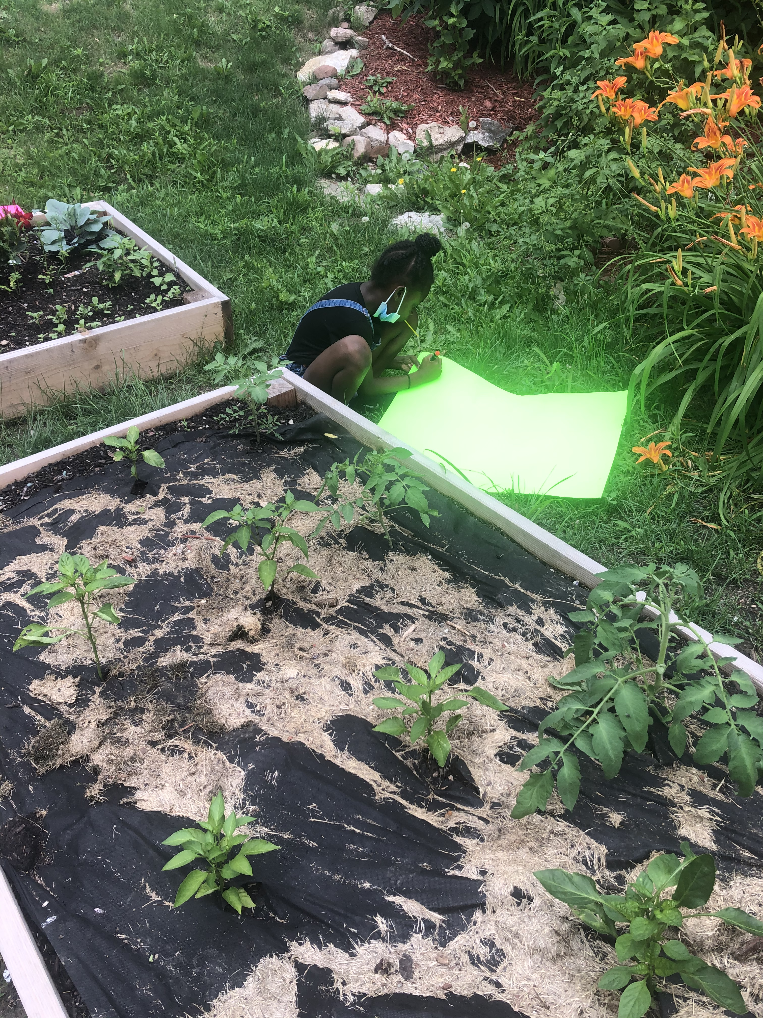
What is GROWING in this garden bed…???
TOMATOES
&
PEPPERS

Slide 6
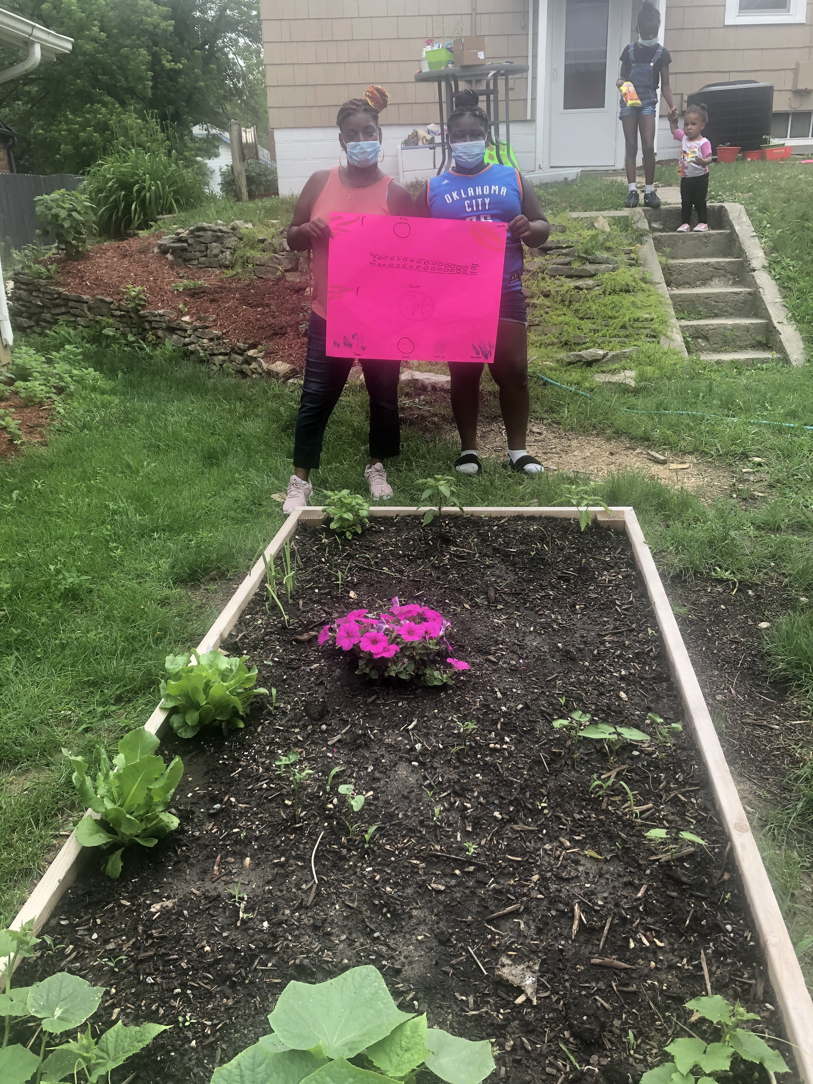
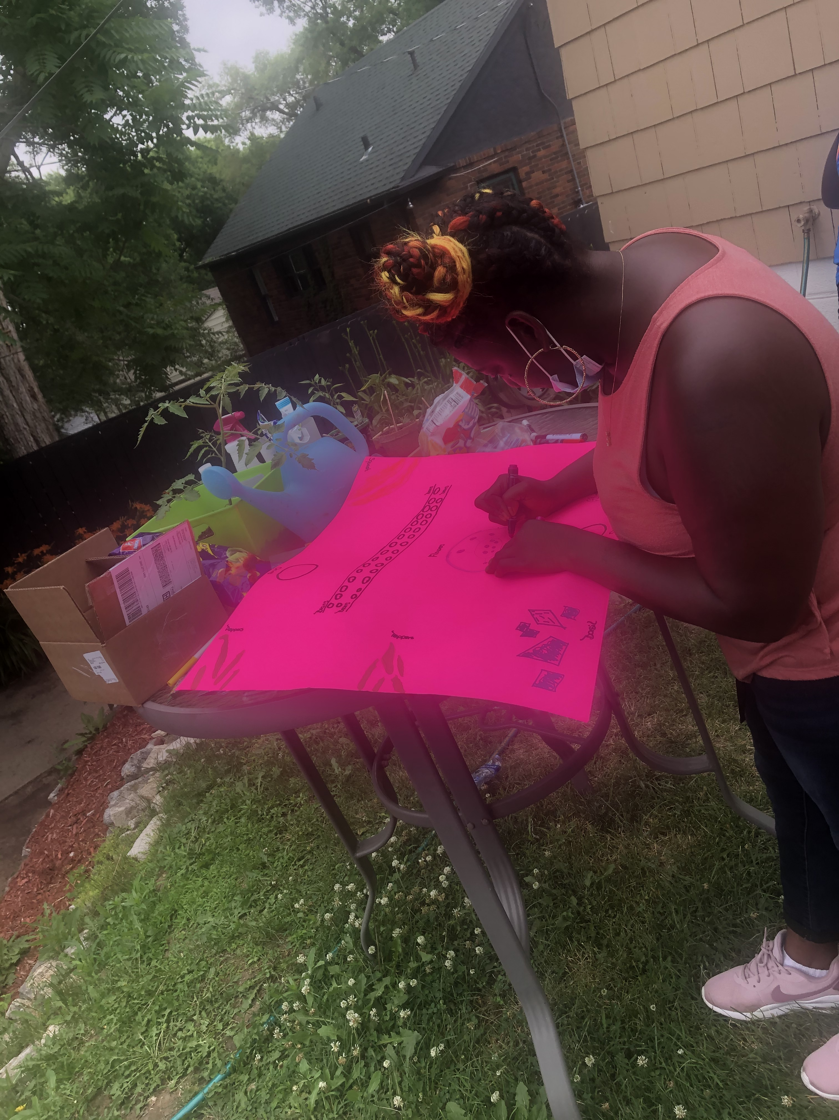
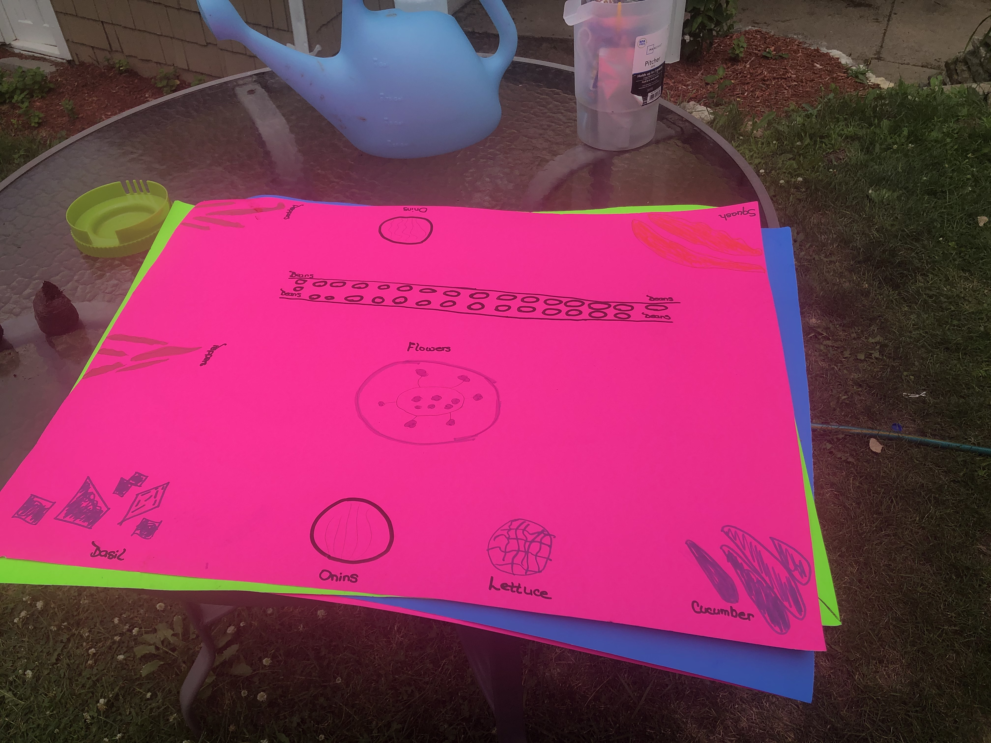
The Epperson family’s garden poster…
Cucumbers
Peppers
Squash
Tomatoes
Lettuce
Beans
Basil

Slide 7
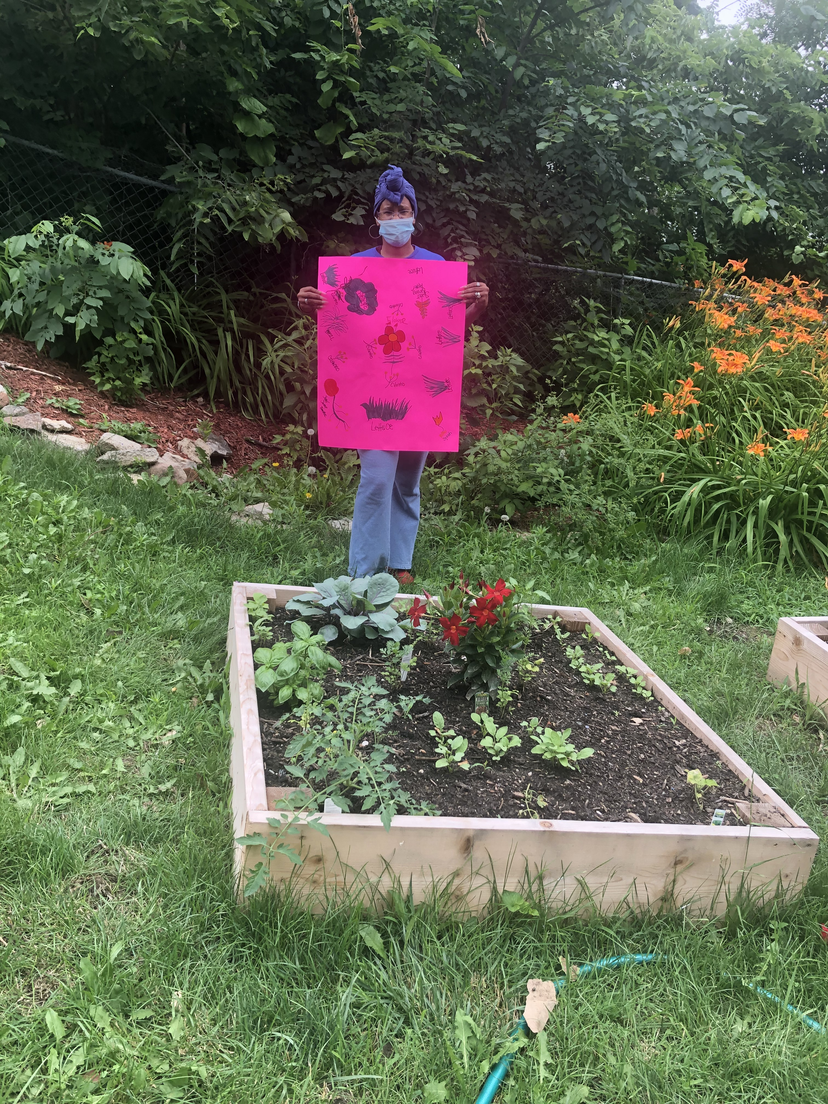
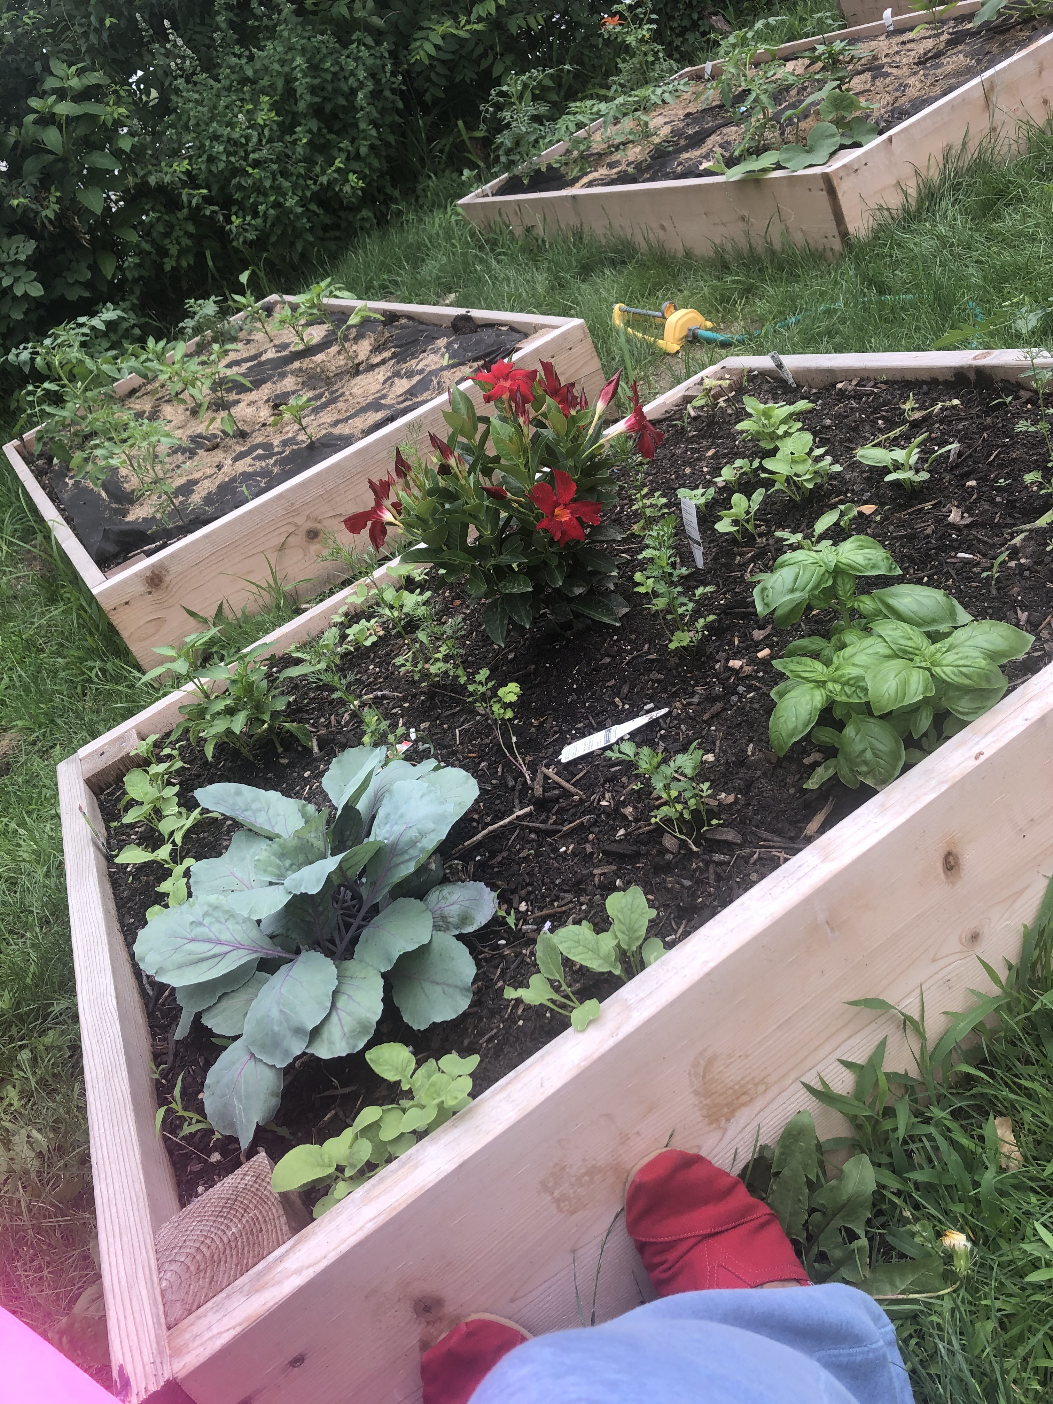
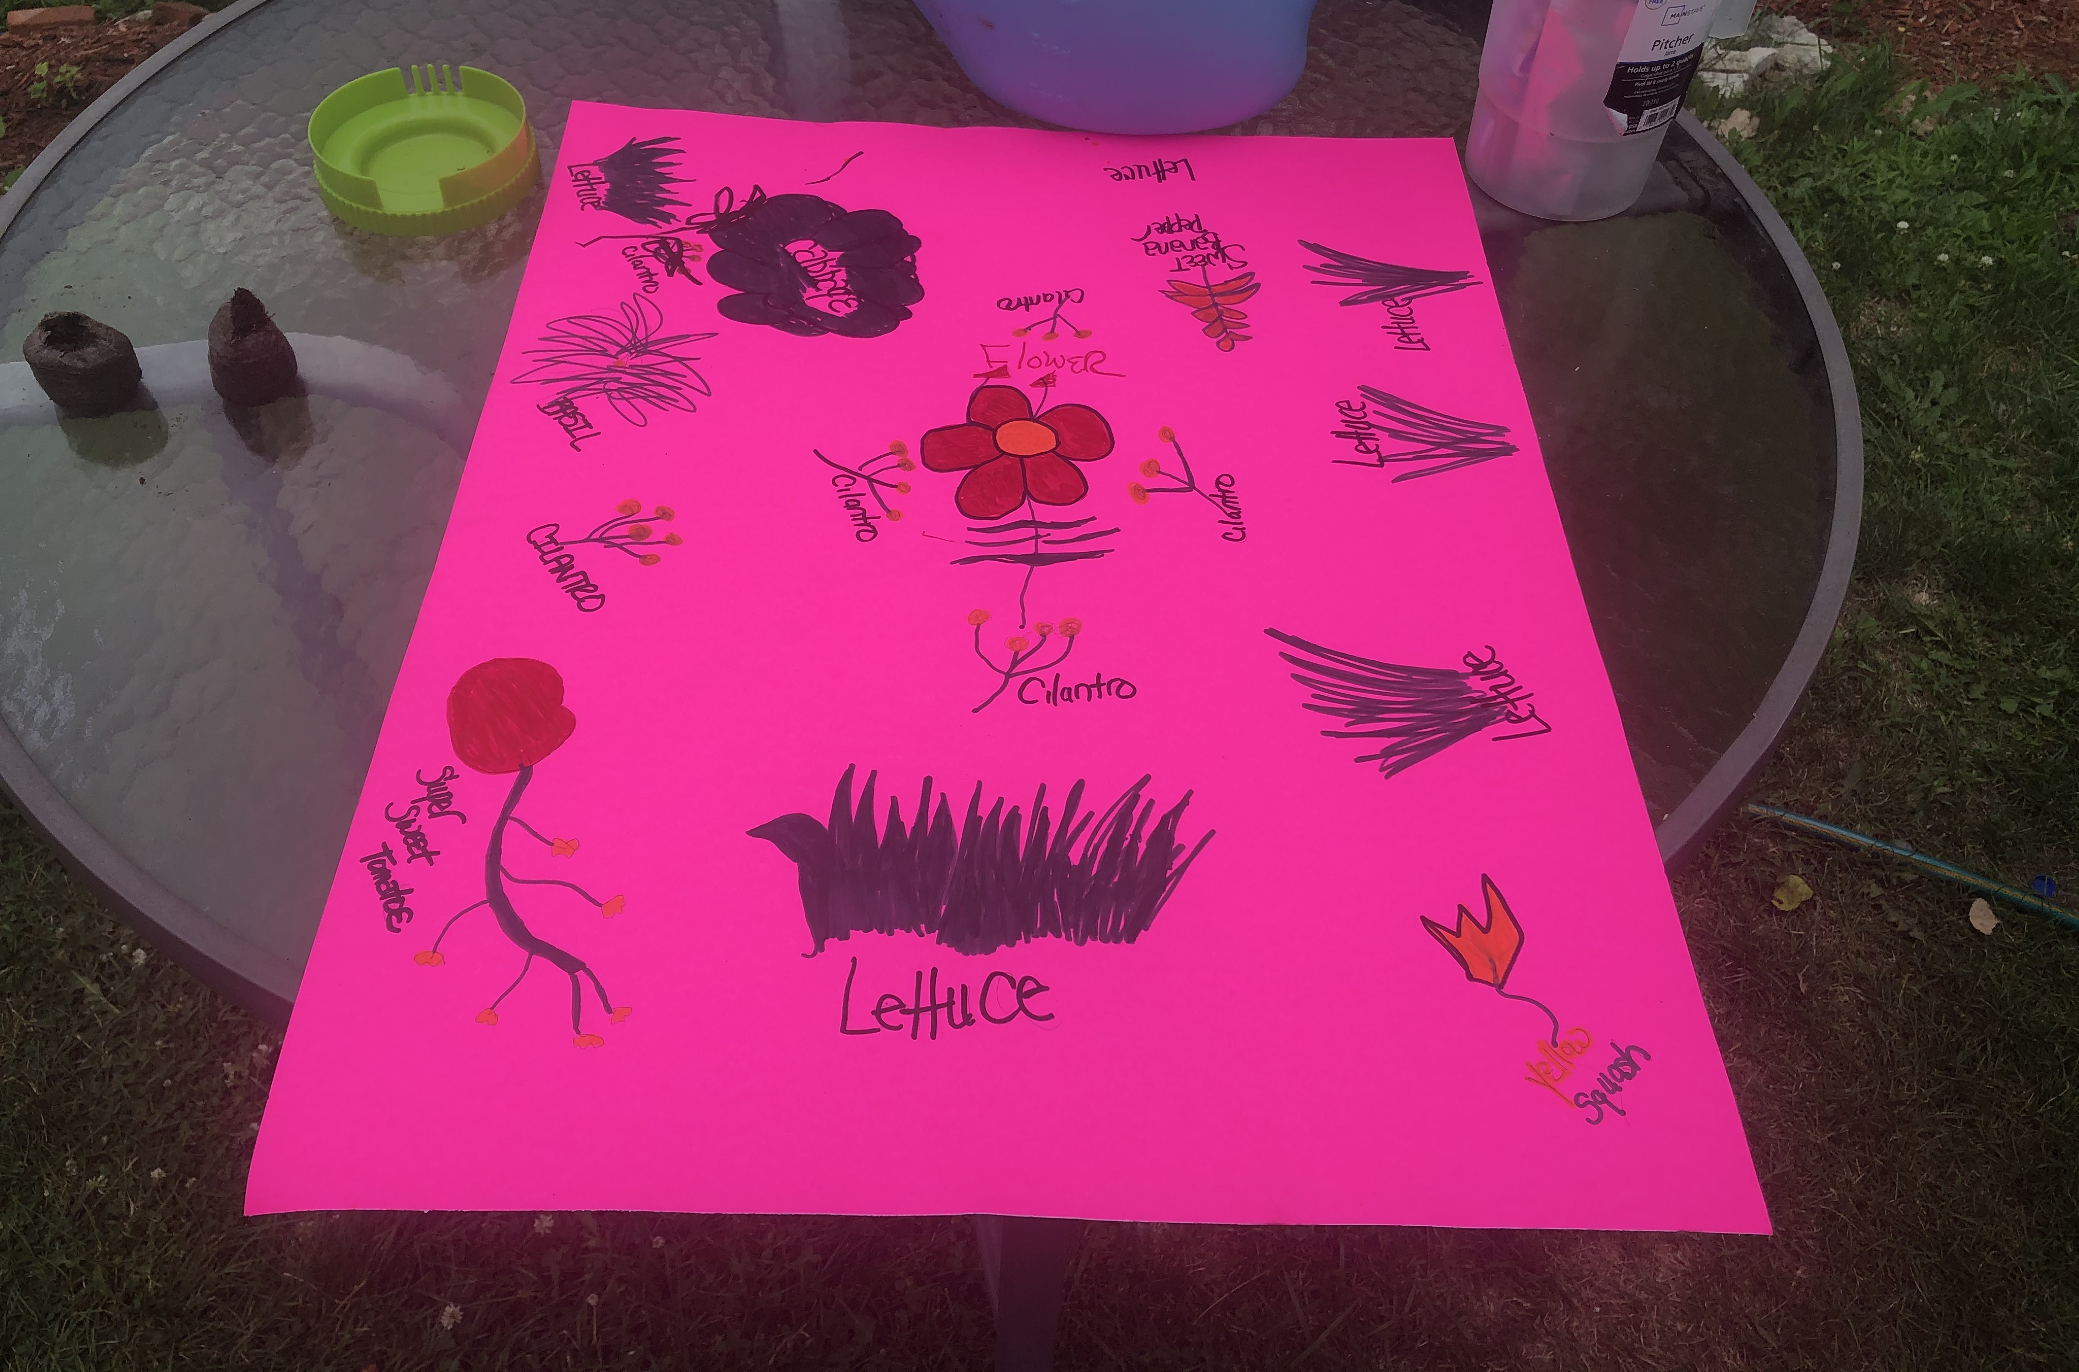
Gooch Garden Bed
Tomatoes
Basil
Cilantro
Squash
Pepper
Cabbage

